Slide 1
The Fundamentals of Airflow
AMCA & O’Dell Associates Education Series | Session 3 | October 14, 2021

Slide 2

Lisa Cherney
Education Manager, AMCA International
Webinar Moderator
• Joined AMCA in February 2019
• Responsible for development of AMCA’s education programs; staff liaison for the Education & Training Committee
• Projects include webinars, AMCA’s online learning platform programming, presentations at trade shows, PDH/RCEP account management, and AMCA’s Speakers Network

Slide 3
Introductions & Guidelines
Participation Guidelines:
  Audience will be muted during the session.
  Questions can be submitted anytime via the Airmeet platform and will be addressed at the end of the presentation.
  Reminder: This session is being recorded!
  To earn PDH credit for today, please stay clicked onto the platform for the entire hour.
  A post-program survey will be emailed to everyone within one hour of the conclusion. Your feedback is greatly appreciated, and the survey must be completed to qualify for today’s PDH credit.

Slide 4
Q & A
To submit questions:
From the interactive panel on the right side of the screen, select the “Q&A” option at the top.
Type your question in the box and click “Send”.
Remember: All attendees can see all questions submitted.
If you would like to verbally ask your question, please click the “Raised Hand” icon at the bottom of your screen.
Questions will be answered at the end of the program.

Slide 5

AMCA International has met the standards and requirements of the Registered Continuing Education Program. Credit earned on completion of this program will be reported to RCEP at RCEP.net. A certificate of completion will be issued to each participant. As such, it does not include content that may be deemed or construed to be an approval or endorsement by the RCEP.
Attendance for the entire presentation AND a completed evaluation are required for PDH credit to be issued.

Slide 6
DISCLAIMER
The information contained in this webinar is provided by AMCA International as an educational service and is not intended to serve as professional engineering and/or manufacturing advice. The views and/or opinions expressed in this educational activity are those of the speaker(s) and do not necessarily represent the views of AMCA International. In making this educational activity available to its members and others, AMCA International is not endorsing, sponsoring or recommending a particular company, product or application. Under no circumstances, including negligence, shall AMCA International be liable for any damages arising out of a party’s reliance upon or use of the content contained in this webinar.

Slide 7
COPYRIGHT MATERIALS
This educational activity is protected by U.S. and International copyright laws. Reproduction, distribution, display and use of the educational activity without written permission of the presenter is prohibited.
© AMCA International 2021

Slide 8

Jason Meinke
Director of Sales – Commercial Products, Twin City Fan & Blower
BS in Civil Engineering from University of Minnesota Twin Cities
Has served the HVAC industry as an engineer and sales leader, focused on energy efficiency, reliability, and quality
Served on several AMCA committees

Slide 9
The Fundamentals of Airflow
Purpose and Learning Objectives
The purpose of this presentation is to provide industry professionals with an overview of the basic concepts and relationships between airflow and pressure, and how these concepts are affected by various outside factors in regard to fans.
At the end of this presentation you will be able to:
Describe the basic components of airflow, how to measure them, and how they relate to each other.
Explain how to read fan curves, and what this knowledge helps to avoid.
Apply the Affinity laws for troubleshooting and solving problems.

Slide 10


Agenda
Section 1: Why the Fundamentals
Section 2: Components of Airflow
Section 3: Power and Efficiency
Section 4: Fan Curves
Section 5: The Affinity Laws
Notes:
GO through agenda
Lastly – Every once and awhile you’re going to see this POST IT appear. When you see this, you’ll know this is something you should try to remember.

Slide 11



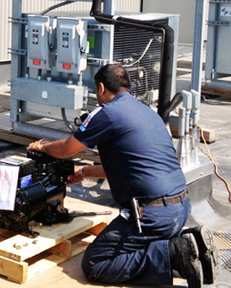

Section 1: Why the Fundamentals
Notes:
Whether you’re a design engineer, service technician, contractor, intern, or manufacturer’s representative. Knowing the fundamentals of airflow will make you better at the work you do in the HVAC Industry.

Slide 12
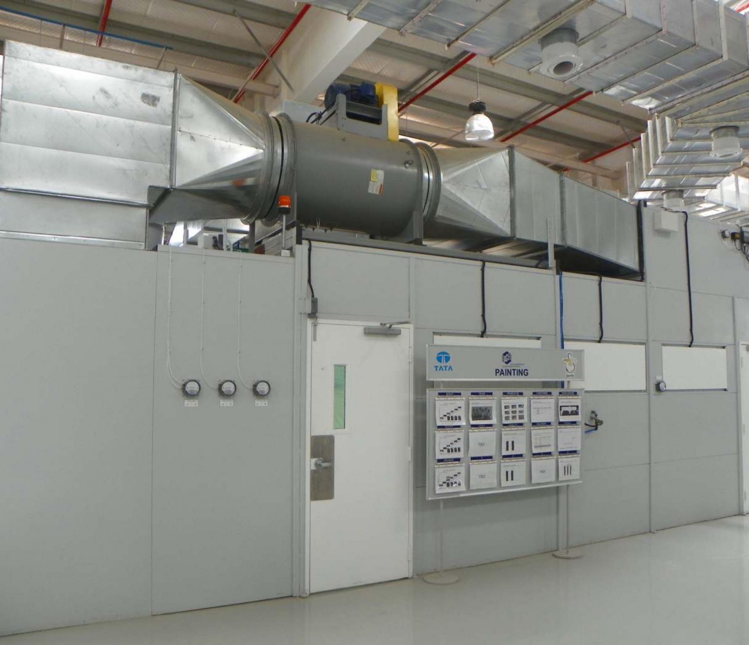
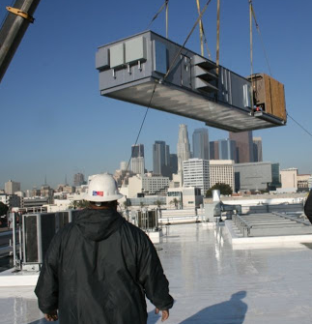
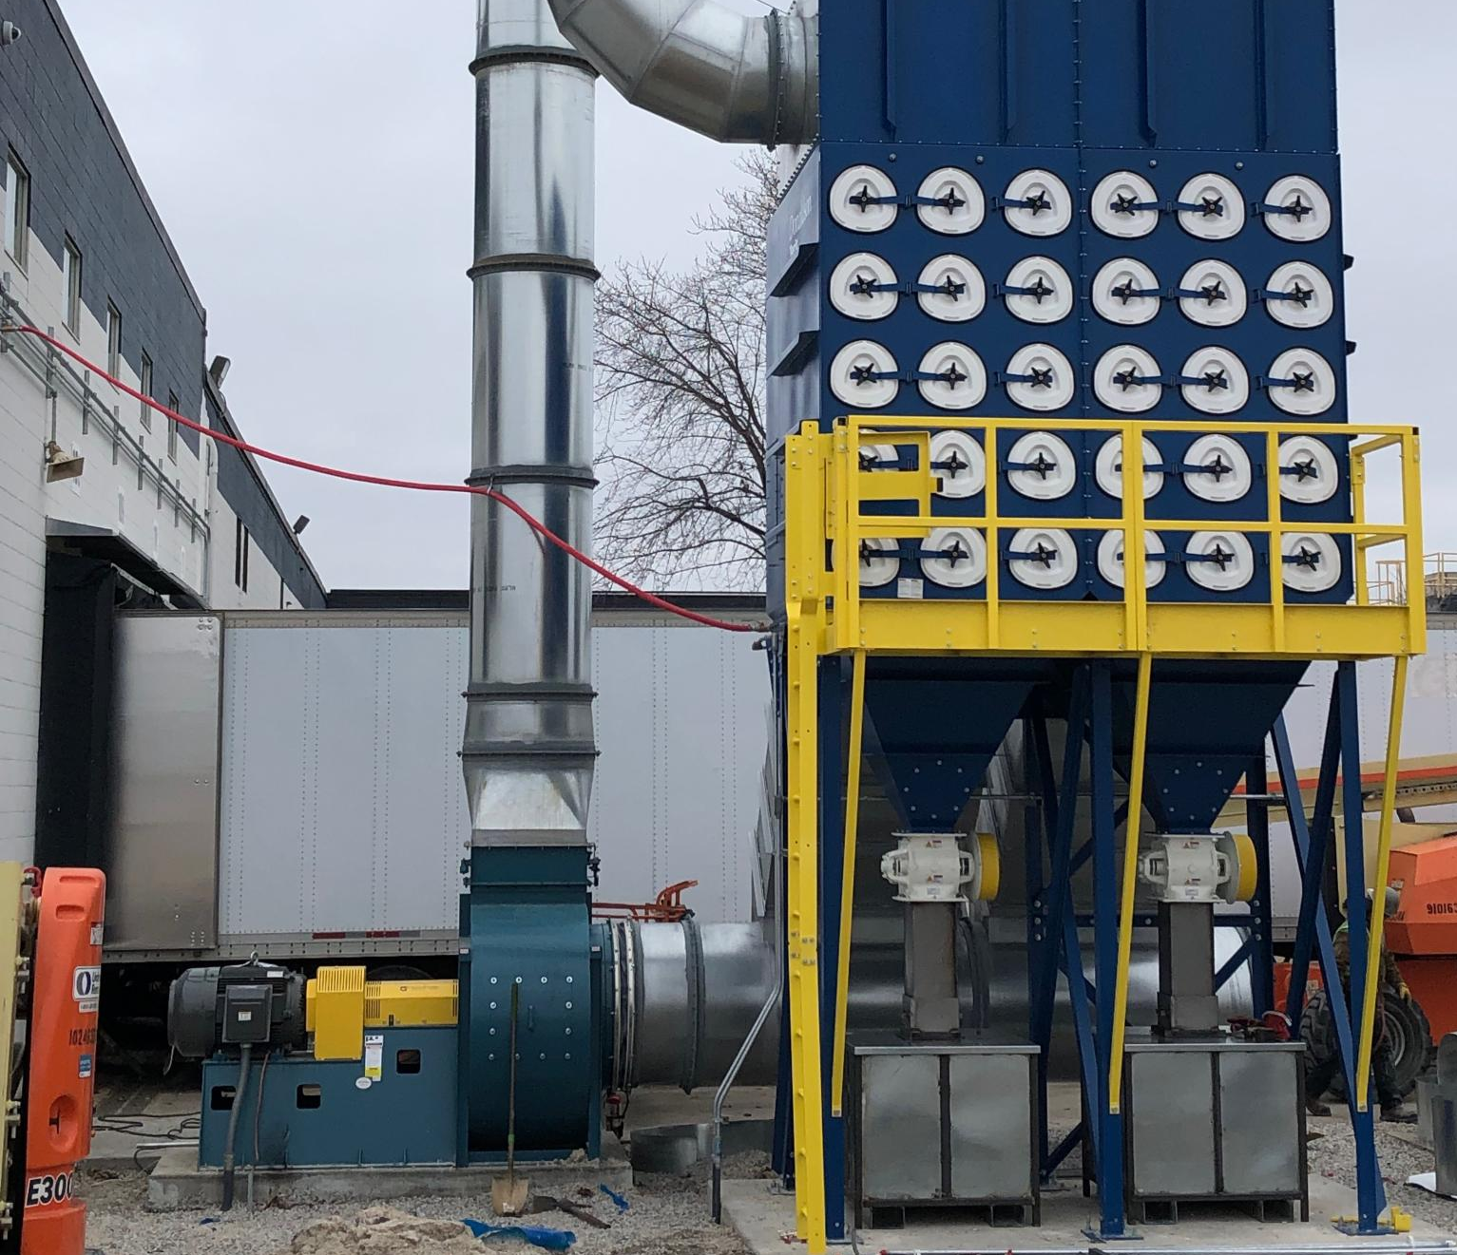
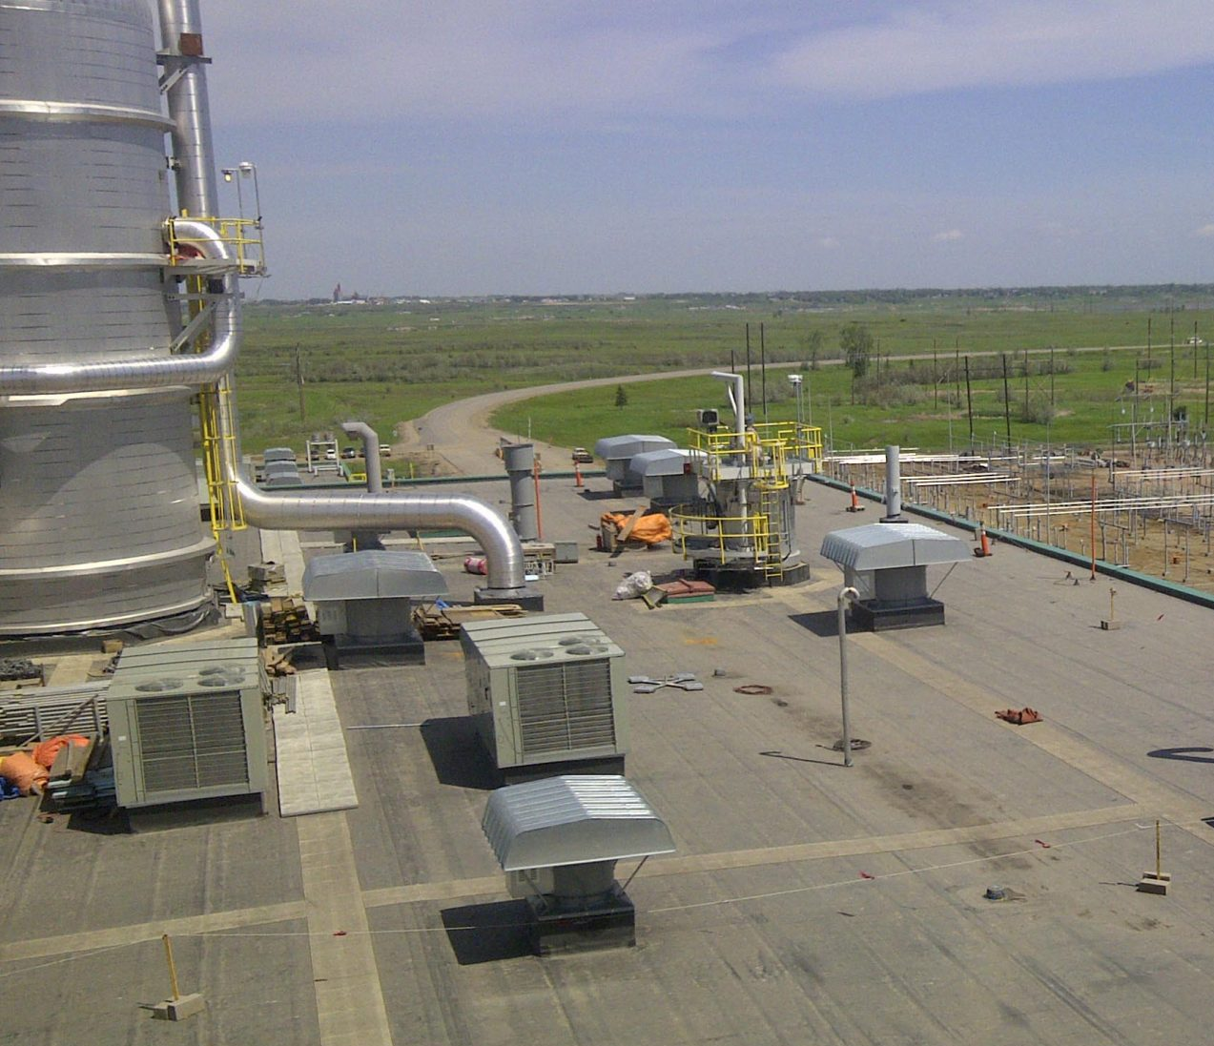
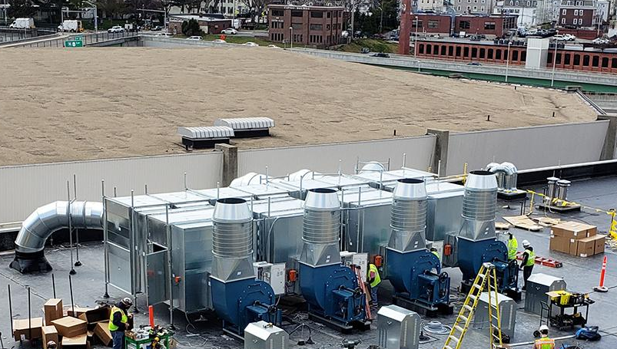
Section 1: Building Your Foundation
Notes:
Throughout the HVAC industry air movement is a key feature of many of the systems. Whether it be Paint booths, roof exhausters, Air Handling Units, Dust Collectors, etc. All of these have one thing in common.

Slide 13

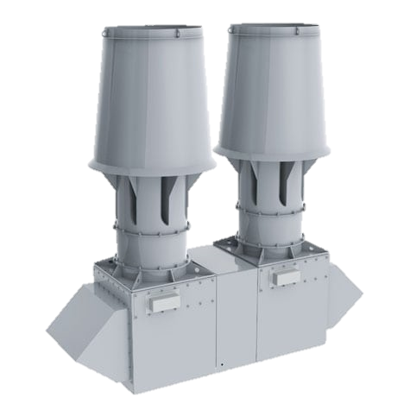
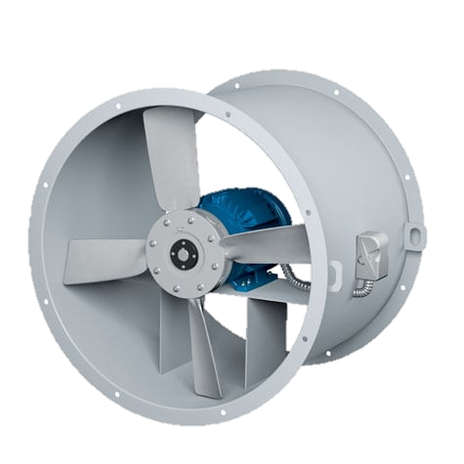
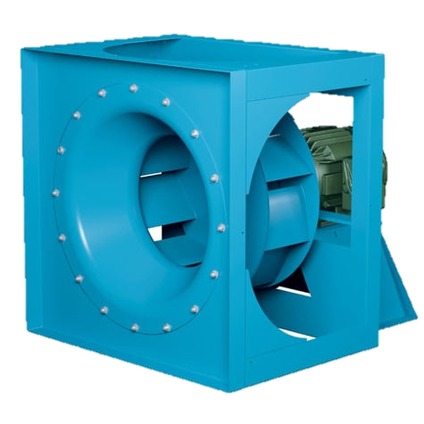
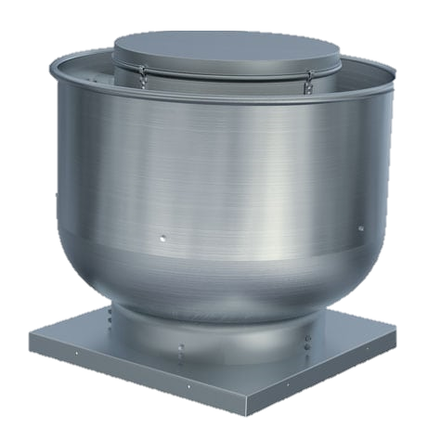

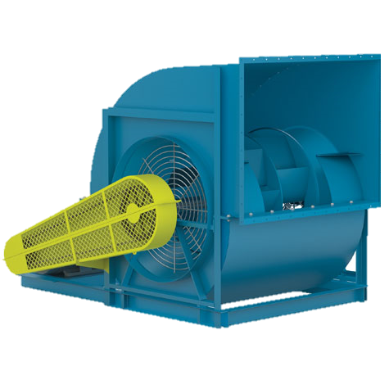
Section 1: Heart of a system
Notes:
The Fan is at the heart of a system.
Like humans every system is different and like humans everyone’s heart is a little different too.

Slide 14

Section 2: Components of Airflow
2
Key Terms and How to Measure them
  Air Density
  Volume
  Pressure
Notes:
Alright – Lets get started by talking about the components of airflow.
In this section we are going to talk about 3 key terms and how to measure them. The first is air density, the second is volume, and the 3rd is pressure -

Slide 15

Section 2: Air Density
Standard air density = 0.075 lb./ft3
Air temperature of 70ºF (21ºC)
Altitude at 0 ft. elevation (sea level)
Barometric pressure of 29.92” Hg (101 kPA)
Specific volume of 13.33 ft3/lb.
Notes:
Definition: The mass per unit volume of earths Atmosphere. What you’re seeing up here is the characteristics of what we call standard density.
As the great Hero George McFly told Lorraine in our favorite 80’s movie Back to the future…You’re my density. It didn’t quite have the effect he had hoped for, but I can tell you it has a big effect when it comes to the fundamentals of airflow. So much so, that I can tell you that it is your destiny that you will see density more than once in this presentation.

Slide 16

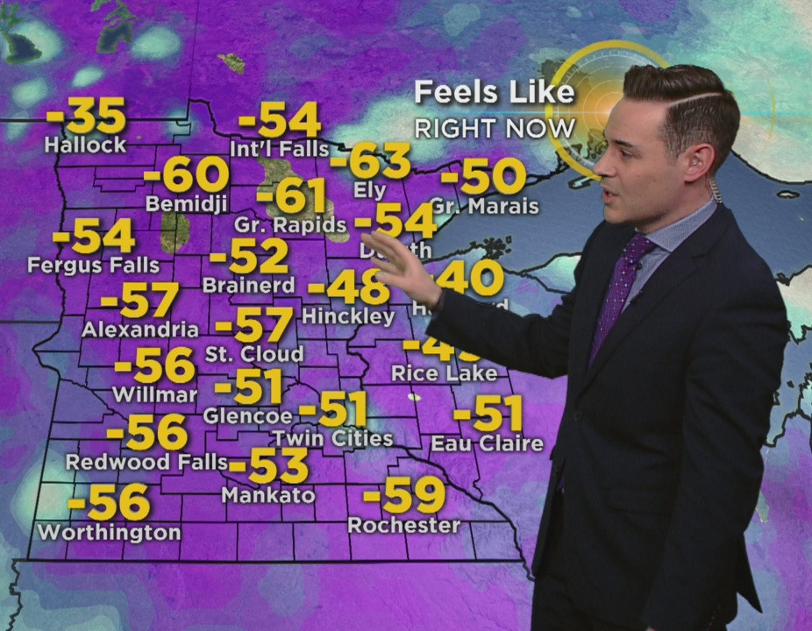
Section 2: Air Density – Temperature Effect
At temperatures above 70ºF, air density is less (lighter air)
At temperatures below 70ºF, air density is greater (heavier air)
Notes:
Let’s talk about how temperature effect density.
Standard air density temperature is at 70 degrees Fahrenheit
At temperatures above 70ºF, air density is less (lighter air), thus SP and BHP are less. These are terms we are going to discuss shortly.
At temperatures below 70ºF, air density is greater (heavier air), thus SP and BHP are greater
What you’re seeing on the bottom part of the screen is an actual screen capture of temperatures in Minnesota. Please feel free to come visit us in January. If you’ve never been ice fishing…you’re in for a treat.

Slide 17


Section 2: Air Density – Altitude
At altitudes above sea level, air density is less (lighter air)
At altitudes below sea level, air density is greater (heavier air)
Notes:
Moving on to how altitude effects air density.
Standard air density altitude is at sea level.
So,
At altitudes above sea level, air density is less (lighter air), thus SP and BHP are less
At altitudes below sea level, air density is greater (heavier air), thus SP and BHP are more
CLICK FORWARD FOR POST IT.
Remember this because this will be especially important during an example we talk about later on in this presentation.

Slide 18

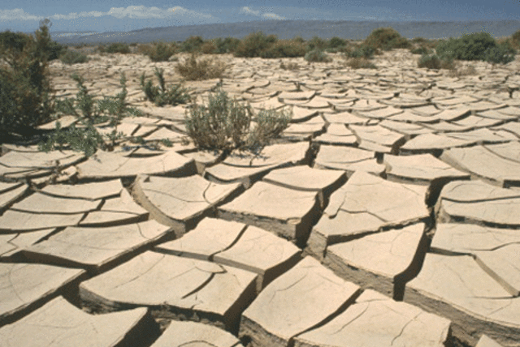
Section 2: Air Density - Humidity
The addition of Water Vapor reduces the density of air (lighter air).
The dryer the air the more dense it will be (heavier air).
Notes:
Lastly – we will talk about how humidity effects air density.
The addition of Water Vapor reduces the density of air (lighter air).
The dryer the air the more dense it will be (heavier air).
This may actually seem counter intuitive, but humid air really is less dense than dry air - This occurs because the molar mass of water (18 g/mol) is less than the molar mass of dry air.
A great example of this is breathing in very humid air. You’ll notice right away that it is more difficult to breathe.
Now – to bring all of these factors together I will bring up Denver again. Normally – Denver is a very dry climate, but sometimes they get hit with a wave of humid air. This coupled with a high temperature and the high altitude would cause the density of the air to plummet. Good thing Denver has the longest runway in America and the seventh longest runway in the world.

Slide 19
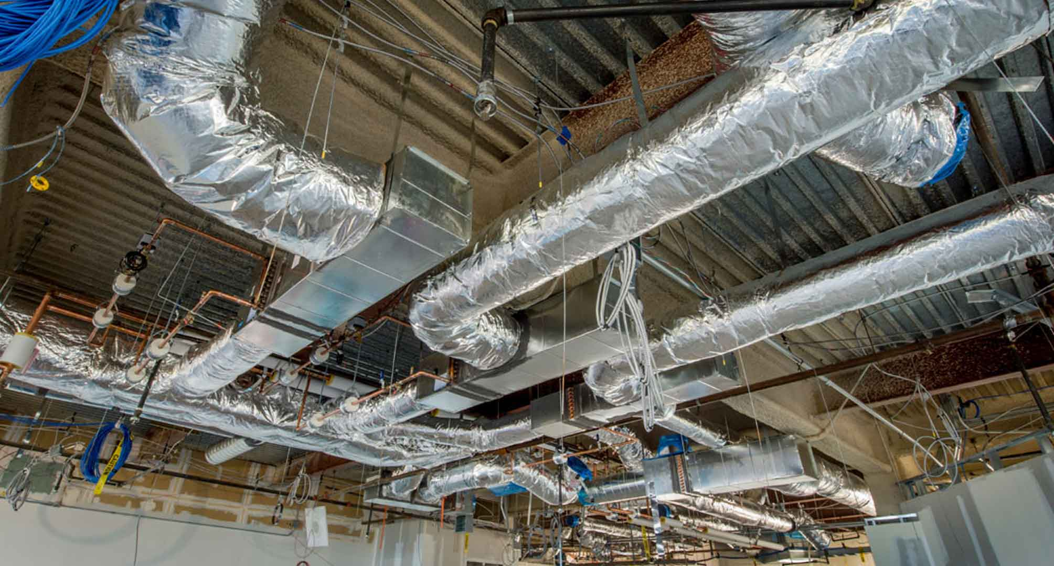
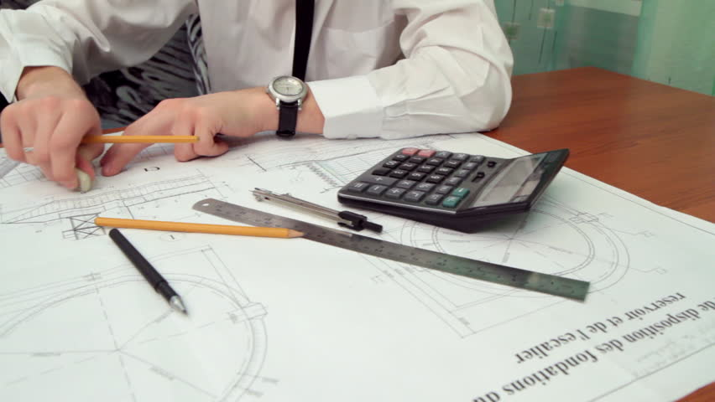
Section 2: Volume
A Requirement to get a job done
Common unit of measure : Cubic Feet per Minute (CFM)
ACFM | SCFM
Actual Cubic Feet Per Minute | Standard Cubic Feet Per Minute
Represents the actual conditions of the job, not corrected to standard density conditions Represents the volume of gas flowing anywhere in the system independent of air density | Volume that gas would occupy if at standard density Selecting a fan when SCFM is specified requires us to calculate the ACFM
Notes:
Moving on to Volume. This is defined as the amount of space that the air occupies.
In the HVAC industry this is often stated as a requirement needed to get a job done.
- This could be air changes per hour, amount of flow to remove particulate, the amount of flow to create enough suction to hold an object, etc.
The unit of measure you’ll see most often in North America is CFM or cubic feet per minute.
Sometimes you’ll see ACFM and SCFM.
ACFM refers to the Actual cubic feet per minute and represents the actual conditions at the job site as shown in the picture on the left.
SCFM refers to Standard cubic feet per minute. This is referring to standard air density. This is most often used on the drawings table and in calculations.

Slide 20
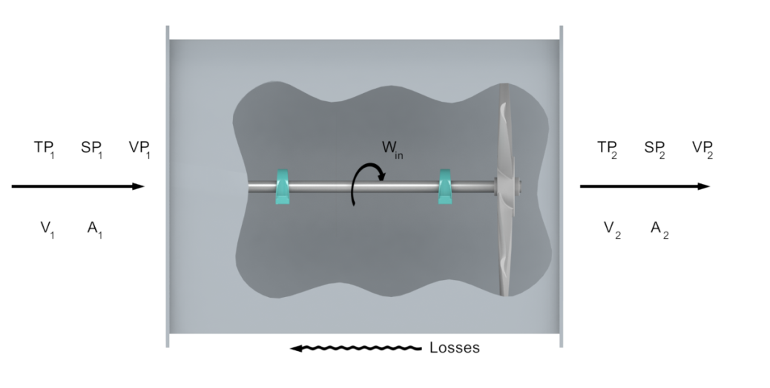
Section 2: Volume (V)
Fan Airflow (CFM)
CFM is based on continuity
V = Volume
A = Area
CFM = V1 A1 = V2 A2
Notes:
One big thing to remember about Volume is that it is constant.
As shown in this picture and illustrated in this equation - The volume going into the fan will equal the volume coming out of the fan.

Slide 21
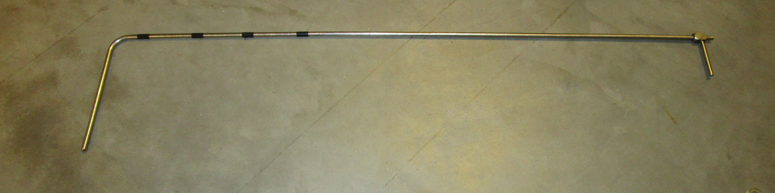
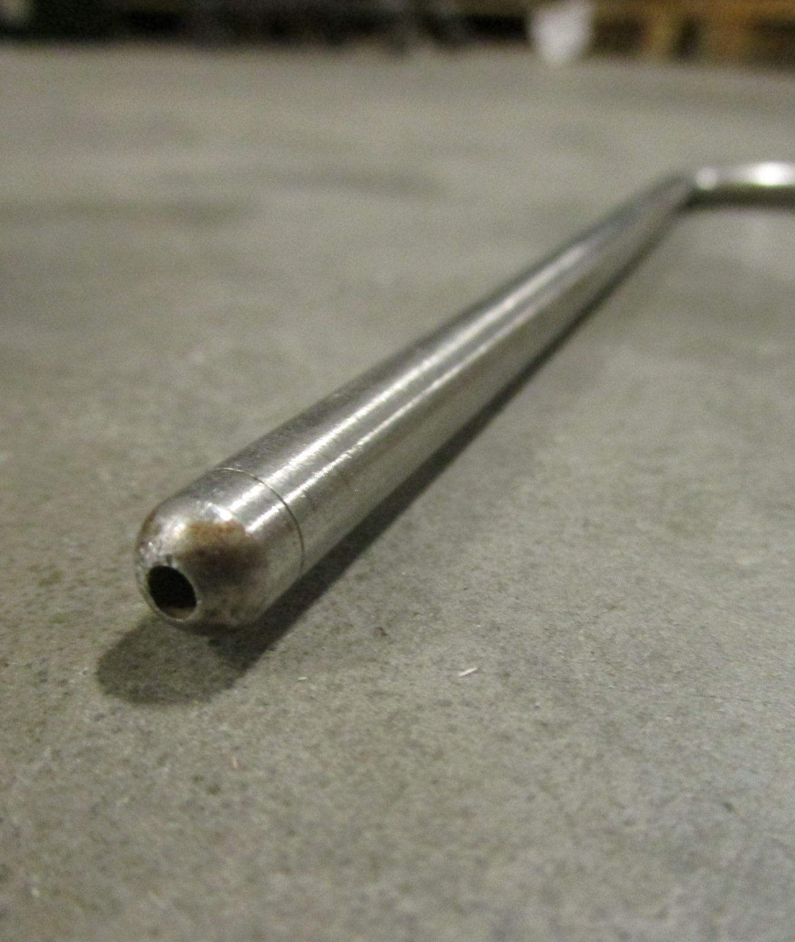
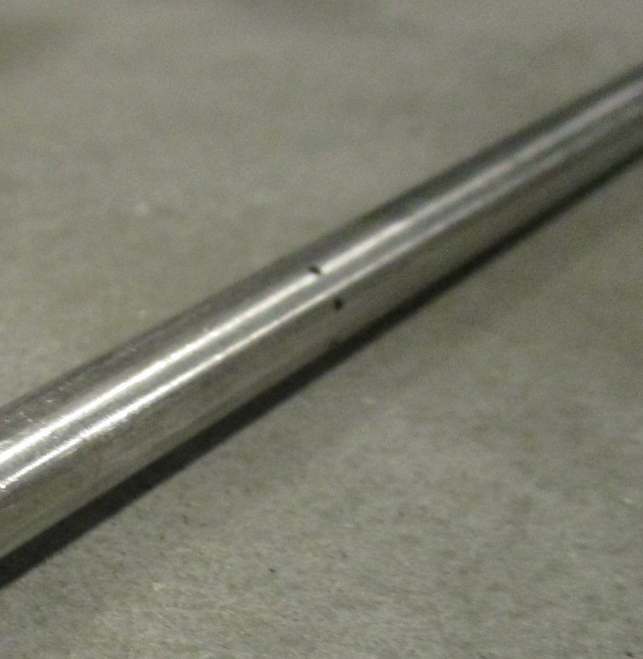
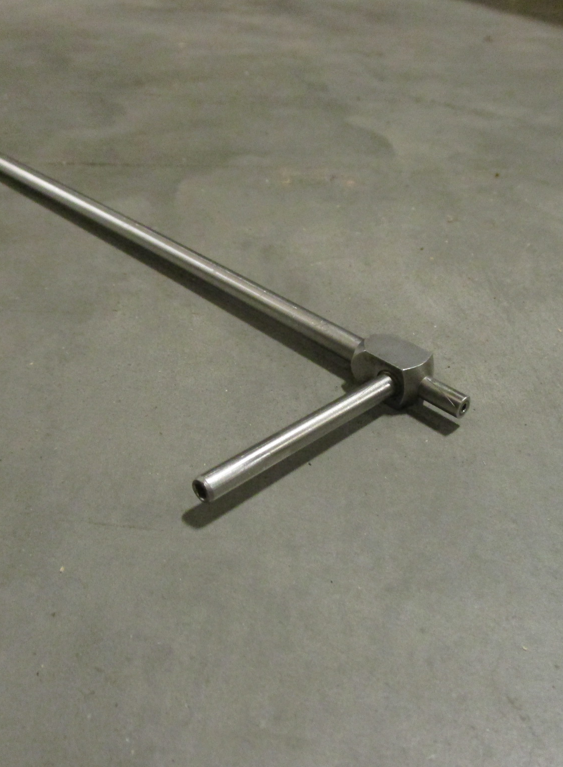
Section 2: Measurement
Notes:
For all of you who do much of your work out in the field or in a test lab this device may look familiar.
This is what we call a Pitot Tube – It is a flow measurement device invented in the early 19th century that is used to measure static pressure and velocity pressure. We’ll learn more about these terms shortly.
The picture on the bottom left shows you the orifice that measures the velocity pressure
The picture in the middle shows you the orifice’s that measure the static pressure
And the picture on the right shows you the point where you can hook up the tubing or connections to your measurement device.

Slide 22
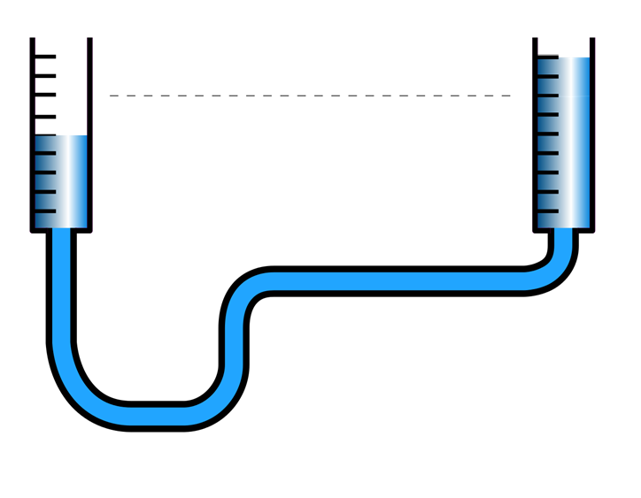
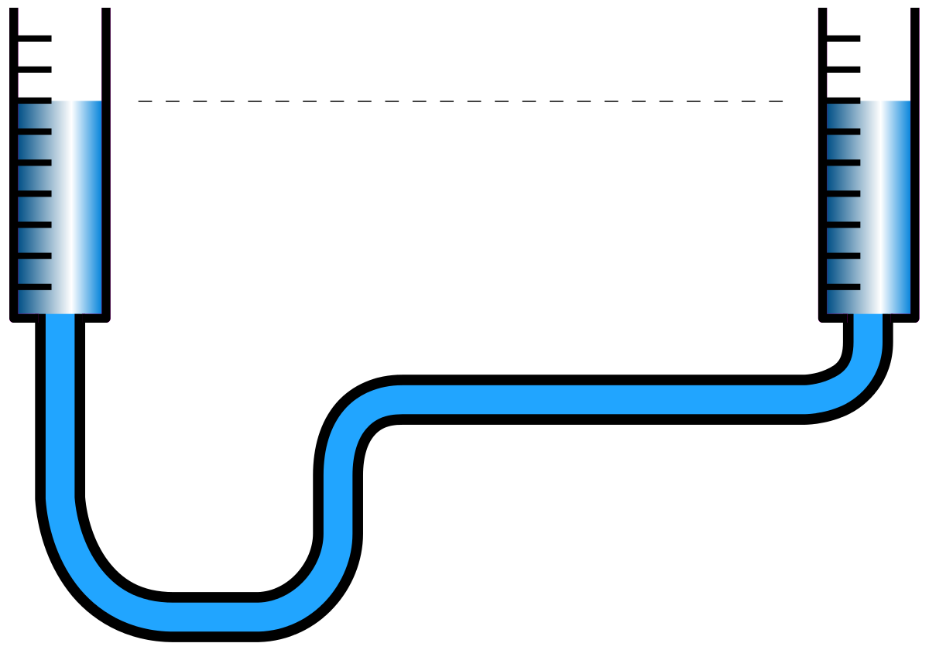

Section 2: Similar to a water level
Notes:
Now - Let’s talk about what that tubing looks like and what its function is.
When not being used this tubing is basically a water level. Before the time of laser levels this was a way to check that two surfaces far apart were level with each other.
However, when doing testing with a Pitot tube it is more similar to blowing into a straw. Which I am very familiar with since I have a 3 year old daughter that loves getting into a little trouble. As the pressure builds on one end of the tube the water is pushed through the tubing. This difference in height is how you take air performance measurements in the field.

Slide 23
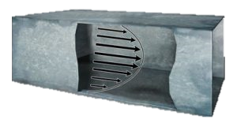
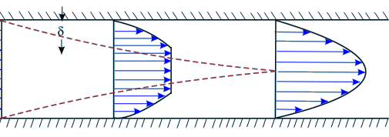
Section 2: Volume (V)
CFM = Velocity (V) * Area (A)
Notes:
Now we need to talk about how air flows through a duct because this is important when taking measurements. You’ll notice in these pictures that the flow is not uniform throughout the cross section. This is why you want to take several readings across your duct. I have included the picture of the pitot tube again because you’ll notice some markings on the pitot tube. These are there as a marker so that consistent measurement spacing can be achieved as you move the tube through the duct cross section.
CLICK FORWARD FOR POST IT!
Don’t forget this. If you are taking measurements in the field, it is imperative to take measurements across the duct!

Slide 24
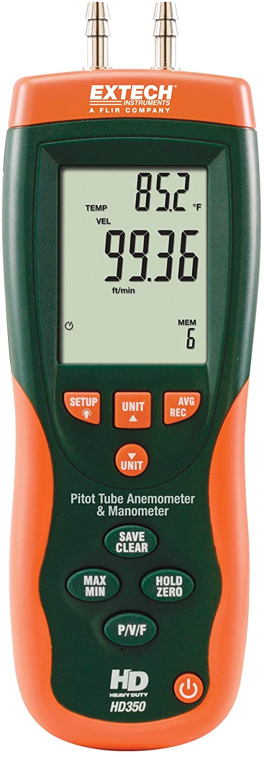
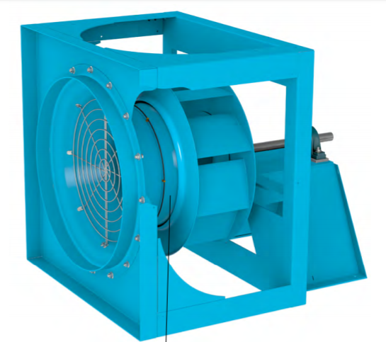
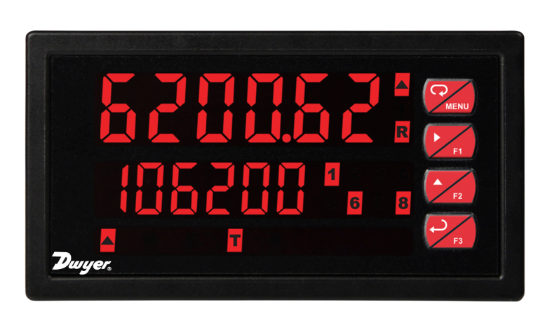
Section 2: Modern Measurement
Notes:
Alright - I’ve now told you about the old-fashioned way for taking measurements.
However, Today there are better options out there that can accomplish this task without the use of a pitot tube. For example, you could use an anemometer shown on the right instead of using the water level trick…
Or you could use a piezometer Ring shown on the throat of the plenum fan inlet cone on the left. Flow can be calculated by measuring the static pressure drop through the inlet cone. The pressure drop is measured from the tap located on the face of the inlet cone to the piezometer ring in the throat. The inlet tap is connected to the high-pressure side of the transducer and the piezometer ring is connected to the low-pressure side.
These can then be connected to a readout that displays your desired unit of measurement.
All this talk about pressure leads us to our next topic…Pressure

Slide 25
Section 2: Pressure
System
Negative vs. Positive Pressure
Static Pressure
Velocity Pressure
Total Pressure
Fan Total Pressure
Fan Static Pressure
Notes:
So – To dive into pressure we’ll cover the following topics
What is a system
The difference between negative pressure and positive pressure
The terms static pressure, velocity pressure, and total pressure.
The lastly, we’ll close out with Fan Total pressure and Fan Static pressure.

Slide 26
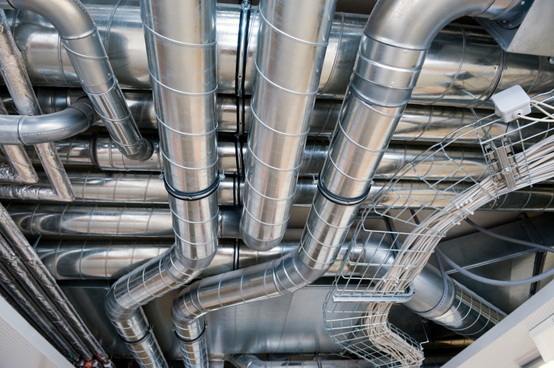
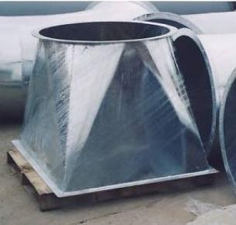
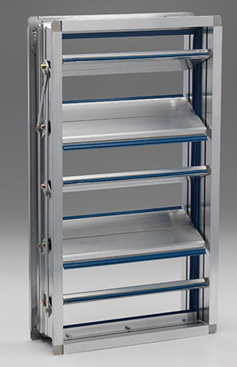
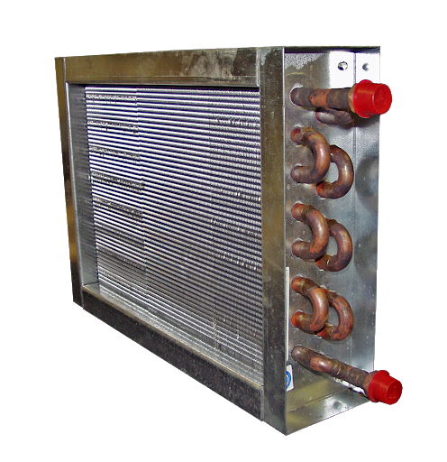
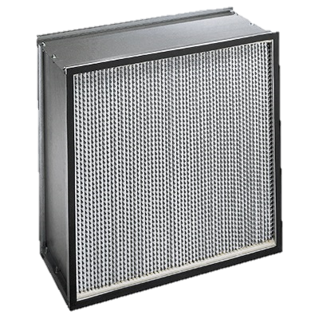
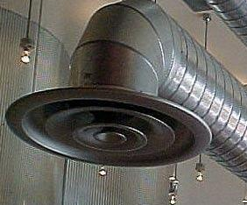
Section 2: System
Notes:
Now, When I talk about a system I am referring to the whole mess of products available on the market. This could be the ducting, the dampers, the coils, the filters, the transitions, the diffusers, etc. All of these make up the system and have a big effect on pressure.

Slide 27
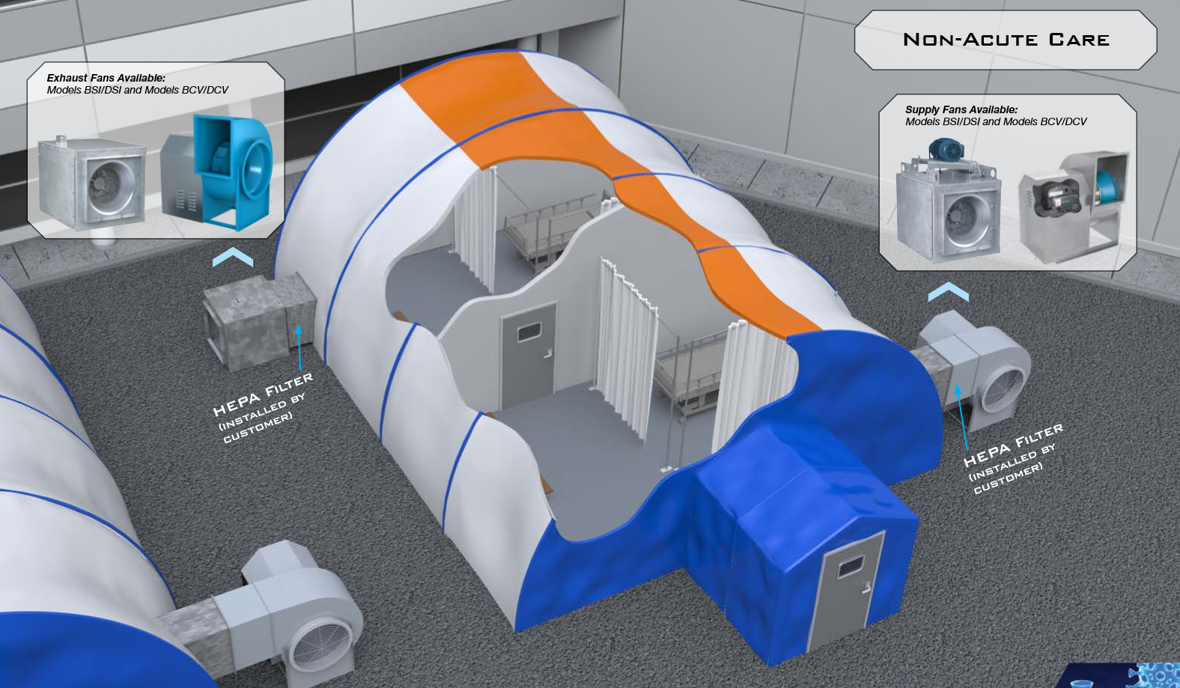
Notes:
Alright – lets talk about positive and negative pressure.
This has been a very important topic as of late due to the Corona Virus Epidemic. This picture depicts an example of a pop-up containment tent that you might see in the field.
The bottom room shows a fan blowing air into the space. This is an example of a positively pressurized room. This is more often used for an immunosuppressed patient that you need to keep the contaminated air out.
The top room is an example of a negatively pressurized room. The fan is pulling the air out of the space through a HEPA Filter. Negatively pressurized rooms are being used as containment spaces. They don’t allow contaminated air to leave the space unless through the fan.

Slide 28
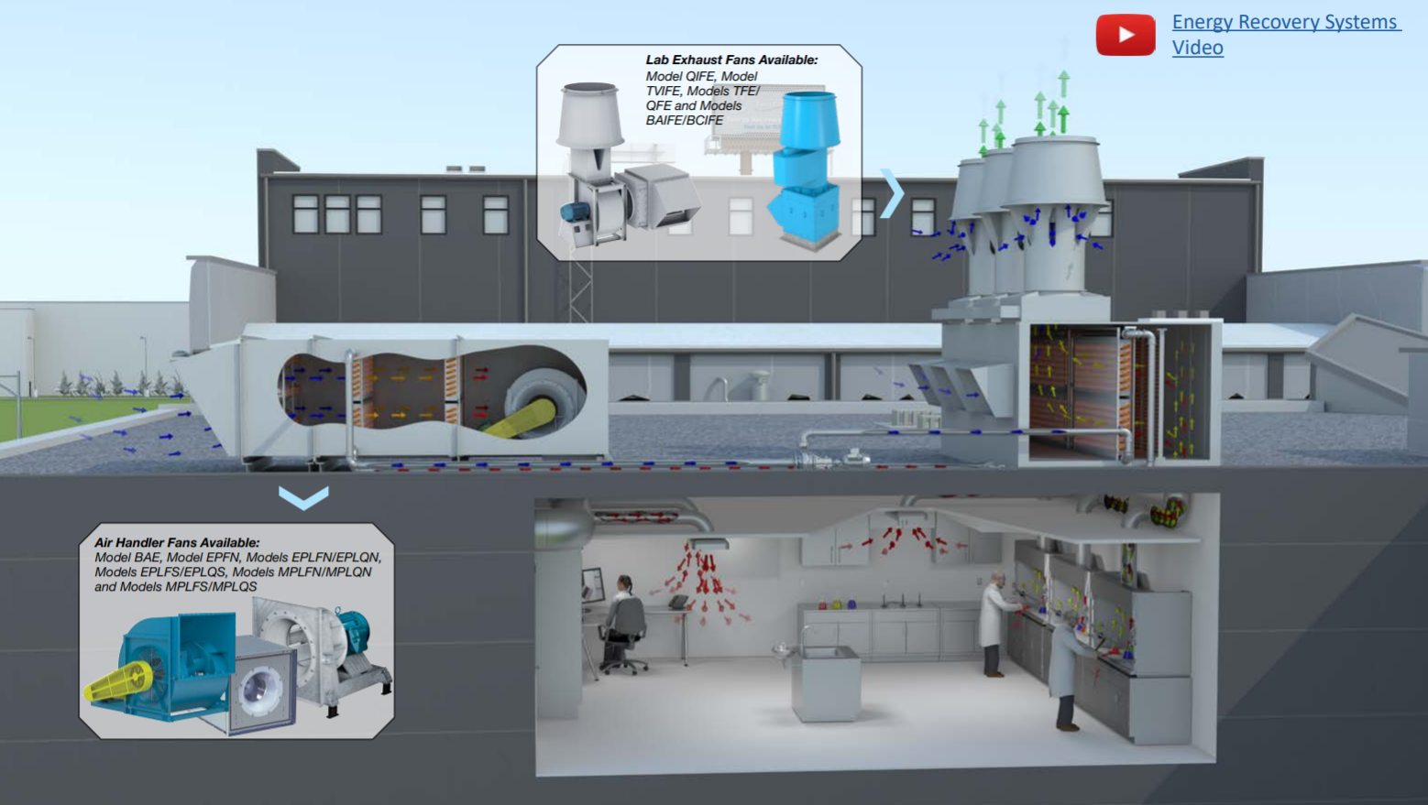
Notes:
This research lab is a great example of a space that would require a positively pressurized space to support a sterile environment. Again, Positively pressurized rooms push Air out of the room to keep contaminated air from entering.

Slide 29
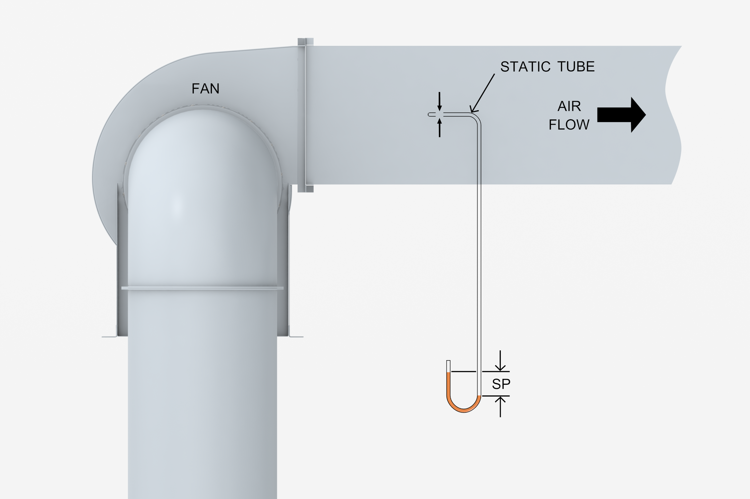

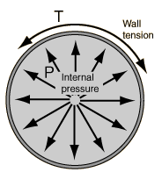
Section 2: Static Pressure (SP)
Definition:
The pressure exerted by air on a surface at rest
Commonly used to specify fan performance
Notes:
So, lets move on to some definitions.
Static pressure is defined as the pressure exerted by air on a surface at rest.
A good example of this is when you blow into a balloon. The rubber balloon is similar to the duct – as you push air through the space it creates static pressure. The more and more air you try to push through the opening the higher the tension that is created.
This is most commonly used when specifying fan performance.
You can see in the picture on the right that this is measured using the static pressure portion of the pitot tube.

Slide 30
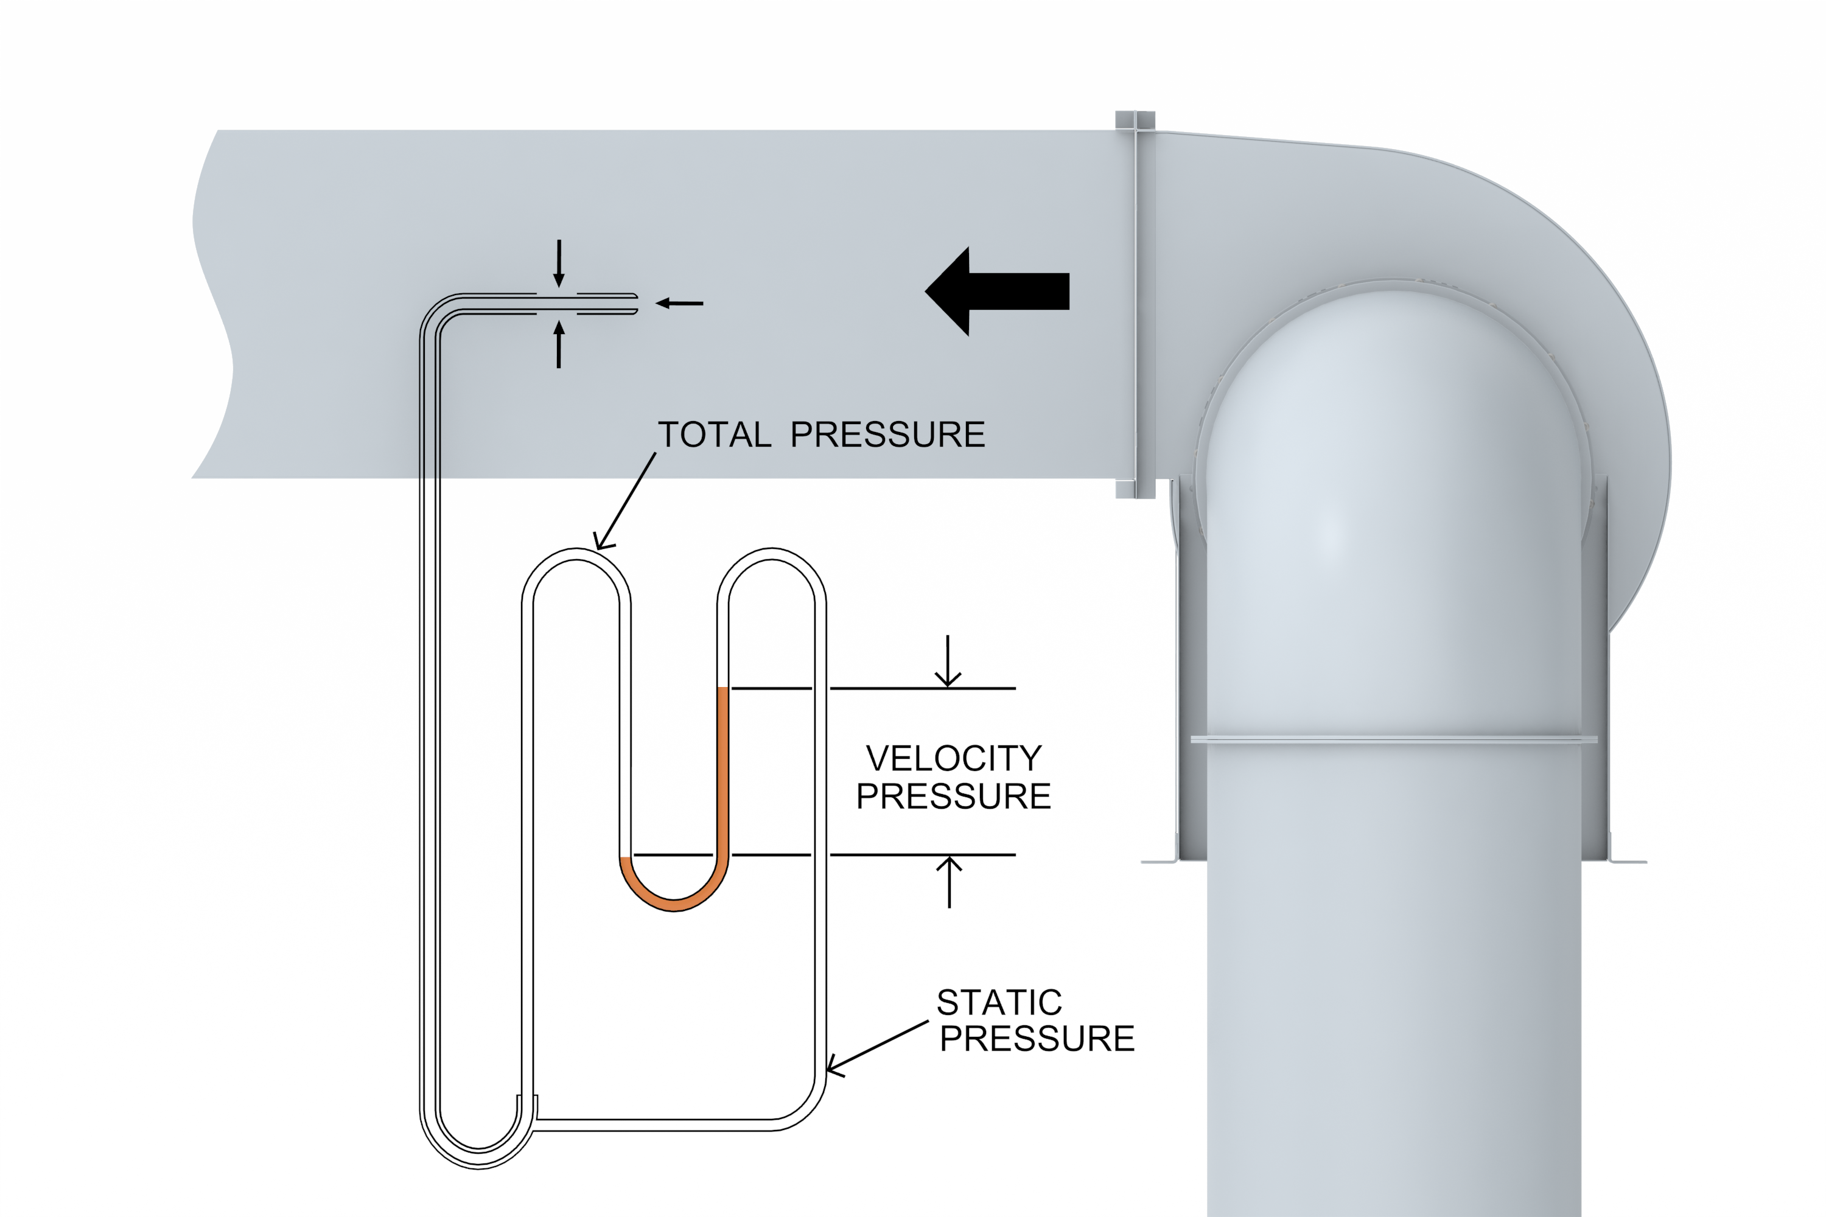
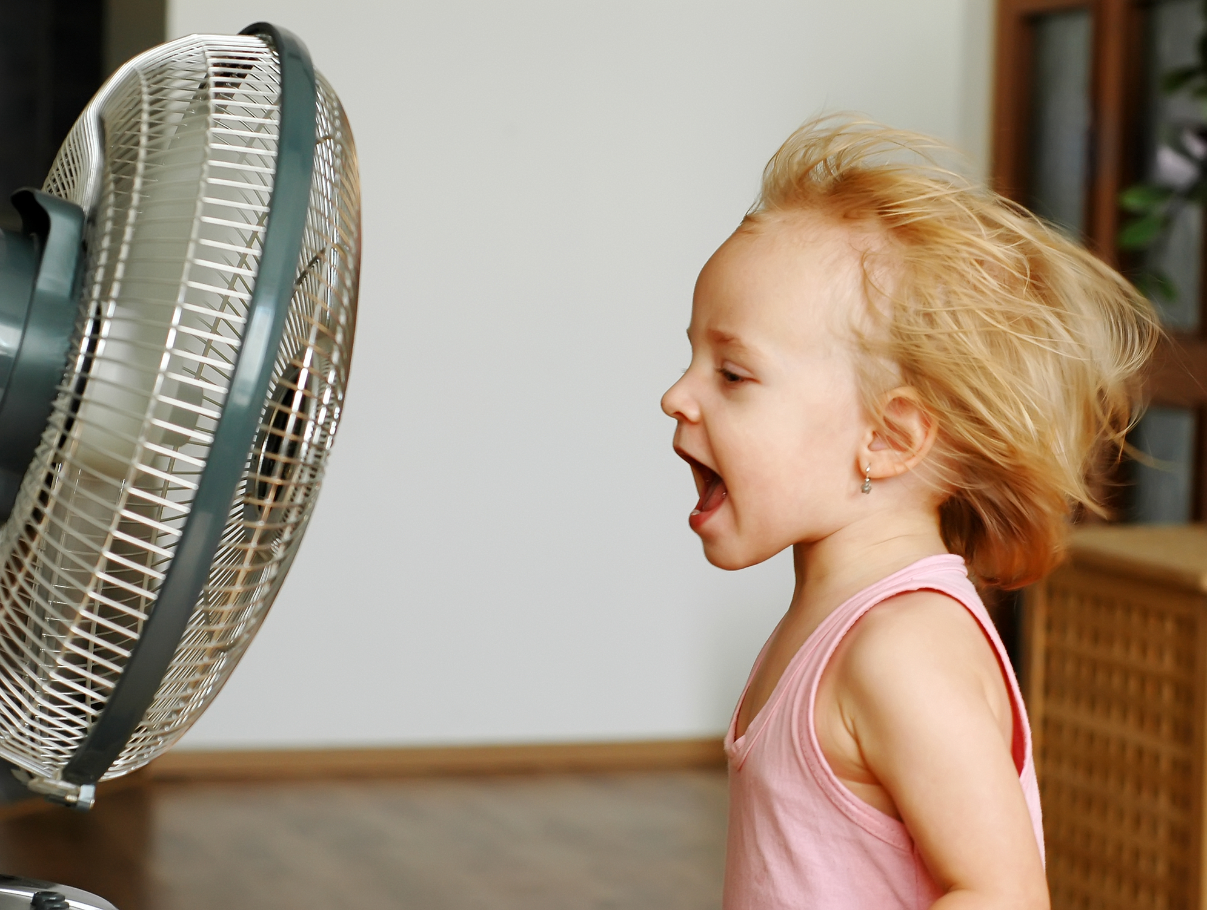
Section 2: Velocity Pressure (VP)
Definition:
The Kinetic energy per unit volume
Equation
VP = ρ (V / 1098)²
ρ = Density in lb./ft³
V = Velocity in FPM
At standard air
VP = (V / 4009)²
Airflow (CFM) ⁼ V * Area (ft²)
Notes:
Moving on to velocity pressure.
This is defined as the kinetic energy per unit volume. A good example of this is when you step in front of a fan. What you are feeling is actually the velocity pressure created by the movement of the air.
CLICK FORWARD FOR POST IT!
This is one of the most useful terms to remember and measure in the field because it can help you calculate your airflow!
If you measure and average the velocity pressure across the duct you can take that measurement and place it in one of these equations. For simplicity I will explain the equation at standard air. First – the 4009 is a unit conversion constant. Take your Measurement at VP and solve for V (velocity in feet per minute). Then plug that into the airflow equation at the bottom along with your duct cross sectional area to calculate your airflow.

Slide 31
Section 2: Total Pressure (TP)
Total Pressure Definition:
The Measure of the total energy of the airstream
Equation
Static Pressure (SP) + Velocity Pressure (VP) = Total Pressure (TP)
Notes:
Next, total pressure is just the addition of Static pressure and velocity pressure.
This is the measure of the total energy of the airstream.

Slide 32
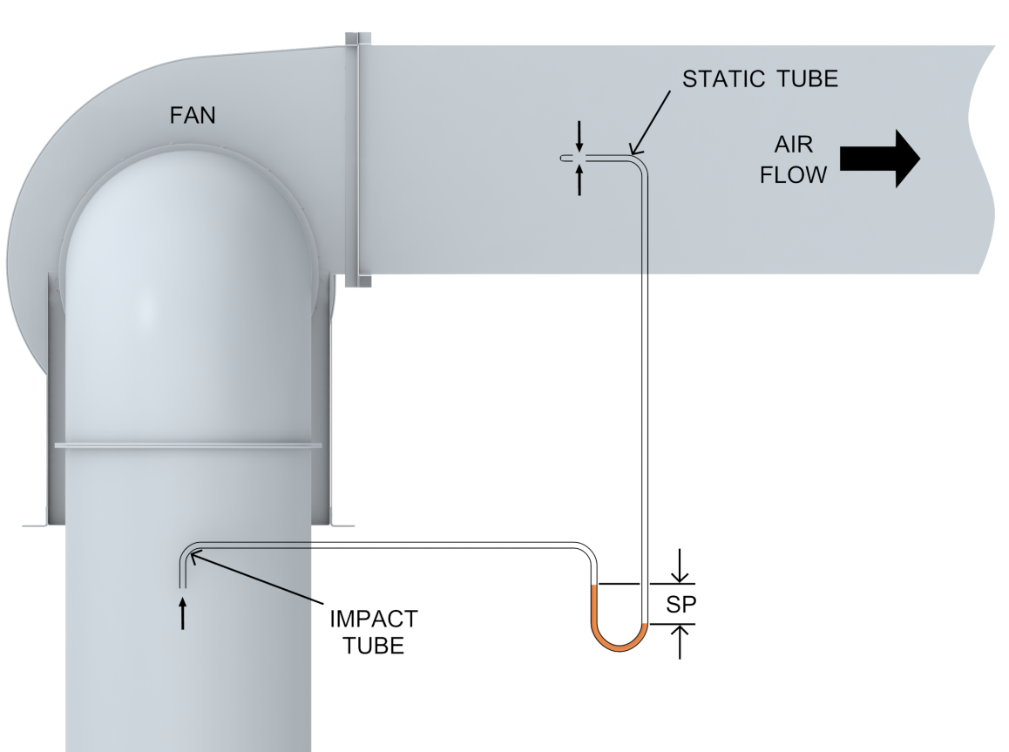
Section 2: Fan Static Pressure (FSP)
This is important because this is used for ratings.
Equation
FSP = SP at outlet – TP at inlet
Notes:
Fan Static Pressure is different from the “regular” static pressure we just talked about. This is all about the fan, as the title says. Fan static pressure is all about overcoming the differential pressure from the outlet and the inlet.
An open Inlet (also known as no ducting), like a plug fan, would have a velocity pressure of 0 and would be similar to regular static pressure.
This is important because this is what fan companies use to rate their fans.

Slide 33

Section 2: Fan Total Pressure (FTP)
Fan Total Pressure Definition:
Total mechanical energy added to the air by the fan
Equation
Fan Total Pressure =
Total Pressure Outlet – Total Pressure Inlet
Notes:
Next – Fan total pressure is similarly focused on the fan and can be defined as the total mechanical energy added to the air by the fan.

Slide 34
Section 3: Power and Efficiency
3
Key Terms:
  - Air Horsepower
  - Brake Horsepower
  - Static Efficiency
  - Total Efficiency
Notes:
Moving on to section 3: Power and Efficiency
Here we will go over the key terms of:
Air Horsepower
Brake Horsepower
Static Efficiency
And Total Efficiency.

Slide 35

Section 3: Air Horsepower
Definition:
Assuming 100% efficiency, the horsepower required to move a given volume of air against given pressure (IP units)
Equations
Static AHP = (CFM x SP) / 6343
Total AHP = (CFM x TP) / 6343
Notes:
Starting off with Air Horsepower. This can be defined as The horsepower required to move a given volume of air against a given pressure, assuming 100% efficiency.
The key to remember here is that this will be used to calculate how efficient a fan is operating.
What you see on the right is a good depiction of this device and is advertised on amazon as a perpetual motion machine. Unfortunately, these are currently out of stock. Good news though – Amazon has me on their reminder list for when it is available.

Slide 36
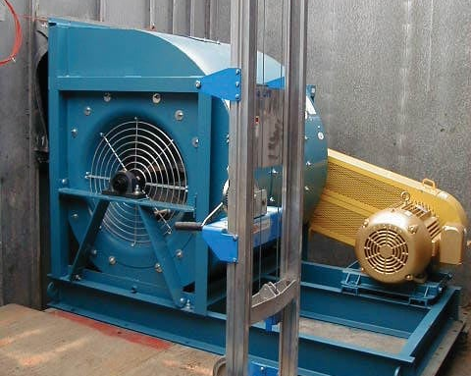
Section 3: Brake Horsepower
Definition:
The actual horsepower a fan requires determined by testing.
BHP > AHP because a fan is not 100% efficient
Notes:
Moving on to Brake Horsepower
CLICK FOR POST IT.
This is one to remember.
This can be defined as the minimum horsepower required to operate the fan at a given RPM for a system
In addition to fan power input, BHP may include power absorbed by V-belt drives or other accessories.
The big takeaway here is – never select a motor less than the given brake horse power required to operate a fan.

Slide 37
Section 3: Static Efficiency
Definition:
Ratio of fan power output to the fan power input
Uses SP, which does not include kinetic energy
Equation
  SE = AHP_{SP} / BHP
  SE = (CFM x SP) / (6343 x BHP)
Notes:
Next we’re going to talk about static efficiency.
To calculate this we need to take our Air horsepower based on static pressure, which we talked about 2 slides ago, and divide by our required brake horsepower as shown in the equations below. This will return a percentage stating how efficient the fan is operating.
Efficiency is specifically important right now in the fan industry. Many of you may have heard about the Fan Energy Index that AMCA and its industry partners helped develop. Once enforced, this will be key in reducing the enormous amount of power consumed by fans across the globe.

Slide 38
Section 3: Total Efficiency
Definition:
Ratio of total fan power output to the fan power input. Also referred to as Mechanical Efficiency.
Uses TP, which includes kinetic energy
Equation
  TE = AHP_{TP} / BHP
  TE = (CFM x TP) / (6343 x BHP)
Notes:
Moving on to Total Efficiency. This can be defined as the ratio of the total fan power output to the fan power input and is also referred to as mechanical efficiency. This is similarly calculated as the last slide, but instead of using the Air horse power based on static pressure, we are using the air horsepower based on total pressure.

Slide 39
Section 3: How Energy Flows through a Fan
Energy Equation:
TP1 + Win = TP2 + Losses
and since TP = SP + VP
VP1 + SP1 + Win = VP2 + SP2 + Losses
Win is shaft power transferred to the air
Losses are due to fan inefficiencies and flow losses
Notes:
So to sum this portion of the presentation up, the picture on the right shows how energy flows through a fan.
The total pressure in plus the energy used to move the fan is equal to the total pressure going out plus the losses caused by fan inefficiencies and flow losses.

Slide 40
Section 4: Fan Curves
4
- Introduction to Curves
- System Curve
- Fan Performance Curve
- BHP Curve
- Static Efficiency Curve
- Fan Operating Point
- Total Efficiency Curve
- Fans in Parallel and Series
Notes:
Alright – Section 4. This is the section that will help you to be able to read a fan curve.
We’ll start by introducing you to a basic chart of fan curves and then diving into:
The System Curve
The Fan performance curve
The Brake Horse Power Curve
The Static Efficiency Curve
And the fan operating point
Lastly we’ll touch on the total efficiency curve and how multiple fan configurations can effect this curve

Slide 41
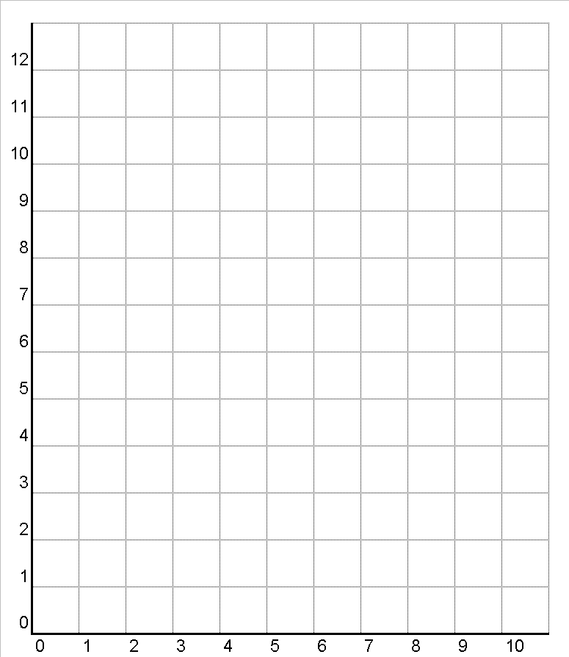
Section 4: Introduction to Curves
System Resistance Curve
BHP Requirement
2
BHP Curve
Point of Operation
1
Fan Performance Curve
Static Pressure
CFM
Notes:
SO what you’re seeing here is a stripped down fan curve.
The X axis at the bottom is defined as the flow or volume of air
The Y axis on the left is defined as static pressure.
Moving forward we’ll identify each one of the curves shown and what it means

Slide 42
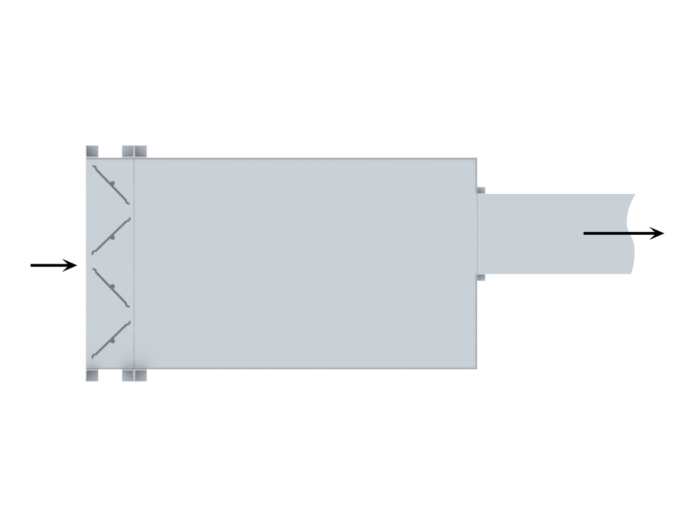
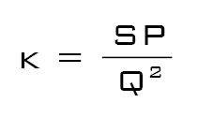
Section 4: System Curve
Pressure Loss = (V^{X}) where X = 2 for turbulent flow
Pressure Loss ~ SP ~ V² ~ Q²
K = A Constant set by the system
SP_{Loss} = kQ² System curve
Notes:
Starting with the system curve – Shown here in blue.
This curve has nothing to do with the fan – it is all about your system
CLICK FOR NEXT SLIDE

Slide 43
Section 2: System
Notes:
Just a quick reminder from section 2. The system could be everything you see here and more.

Slide 44
Section 4: System Curve
Pressure Loss = (V^{X}) where X = 2 for turbulent flow
Pressure Loss ~ SP ~ V² ~ Q²
K = A Constant set by the system
SP_{Loss} = kQ² System curve
Notes:
So – back to the system curve.
The thing to remember here is As flow increases on the X axis, the static pressure on the y axis increases due to resistance of system. Remember when we were talking about the balloon – the more air in the balloon, the higher the pressure. The key however is that this doesn’t increase linearly with the amount air moving through the duct. It increase exponentially as shown.
Using the equations on this slide I am going to show you how this can be useful in a variable air volume application.

Slide 45
Section 4: System Curve
Point 2:
  60,000 CFM
  9 in. wg. SP
$$K= \frac{SP}{Q^{2}}$$
2
$$K= \frac{9"}{{60,000}^{2}}$$
$$.0000000025= \frac{9"}{{60,000}^{2}}$$
Static Pressure
Point 1:
  40,000 CFM
  4 in. wg. SP
1
$$.0000000025= \frac{X}{{40,000}^{2}}$$
$$.0000000025= \frac{4"}{{40,000}^{2}}$$
CFM in 10,000s
Notes:
So during the day we have a fan that operates at 60,000cfm and 9 inches of static pressure. We’d like to save some money on our bills and turn that down when no one is in the building at night. We have figured out the minimum required of flow for our building during these hours is 40,000 cfm. How much static pressure would we need to overcome to achieve this.
Walk through equation….

Slide 46
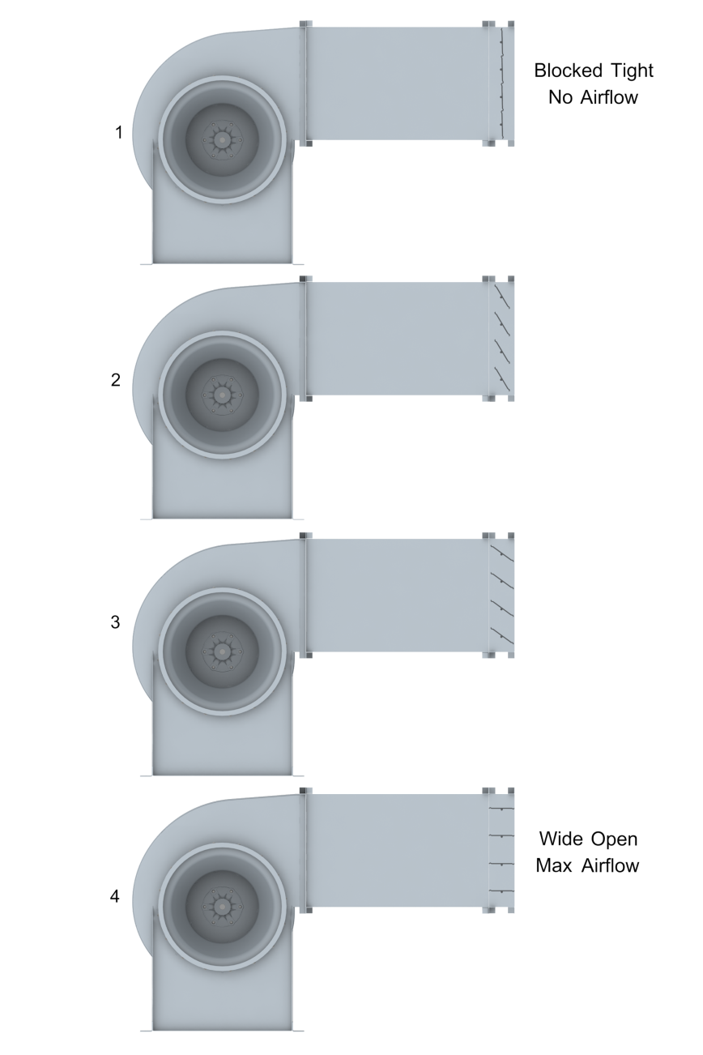
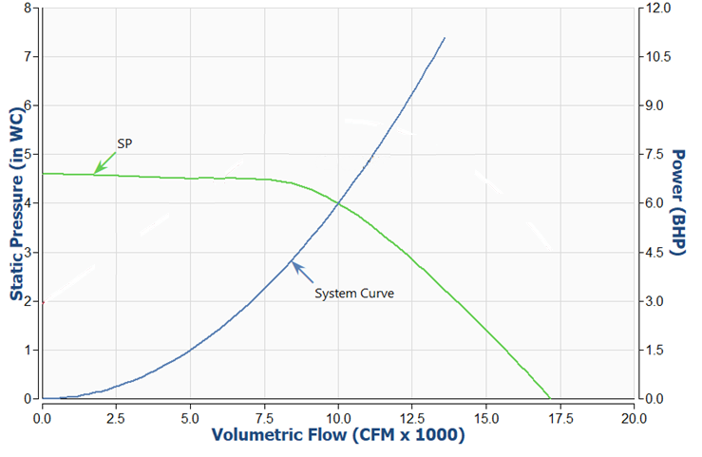
Section 4: Performance Curve (SP)
Blocked Tight
No Airflow
Performance Curve
Wide Open
Max Airflow
Notes:
Next, we’re looking at that performance curve. This is shown in green.
To help visualize the fan performance at different points on the curve we have the pictures on the right. The top fan picture is depicting a fan operating with a completely closed air tight damper. You can see this point on the graph all the way on the left side of the green performance curve. The bottom fan picture is operating at wide open max airflow with the damper wide open. This is depicted all the way on the right portion of the green performance curve.

Slide 47
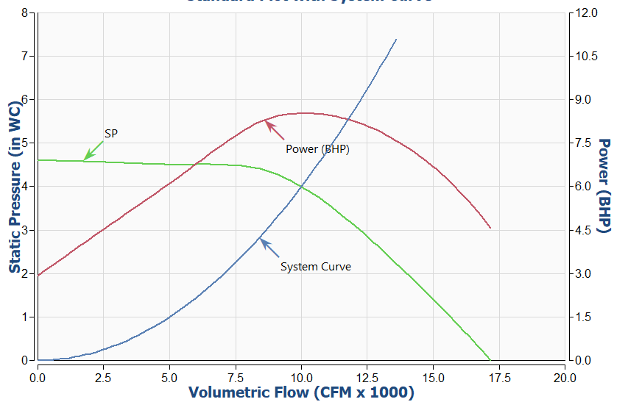
Section 4: BHP Curve
Performance Curve
Notes:
Moving on to the brake horse power curve.
This is shown with as the red curve on the graph above. This curves axis of measurement is on the right side of the graph. You can see that this changes depending on the fan is operating on the performance curve.
This Brake horsepower curve is a great example of what backwardly inclined centrifugal wheel curve would look like.

Slide 48
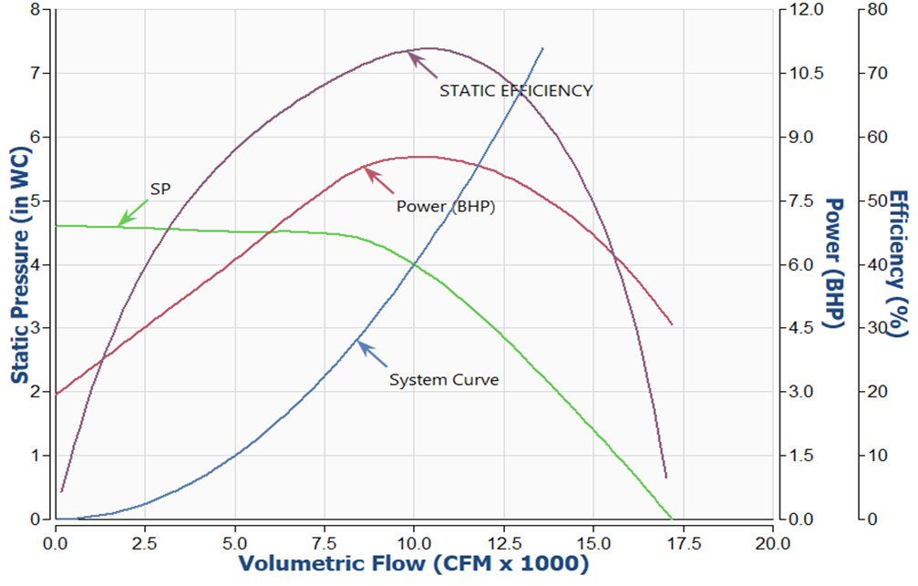
Section 4: Static Efficiency Curve
Performance Curve
Notes:
Next we move on to the static efficiency curve which is depicted in black. This curves axis of measure is the second axis on the right side of the graph. For many fans the “peak efficiency” which is right here – coincides with about 80-90% of the peak of the performance curve shown here in green.

Slide 49
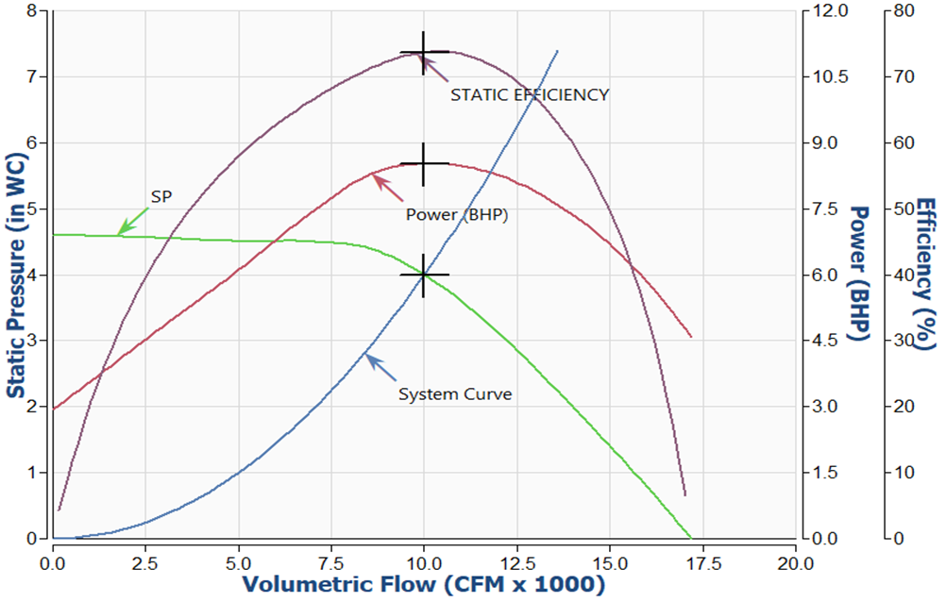
Section 4: Fan Operating Point
Performance Curve
Notes:
Now let’s tie this all together and talk about how to read these curves. The fan operating point is the intersection of the fan performance curve shown in green and the system curve shown in blue. I have marked this with a black cross.
CLICK
The volume or flow of at this operating point is approximately 10,000 CFM
Click
The static pressure at this operating point is approximately 4” water column
Click
The Brake horse power required at this operating point is approximately 8.5 BHP
Click
And the static efficiency of the fan is approximately 73%

Slide 50
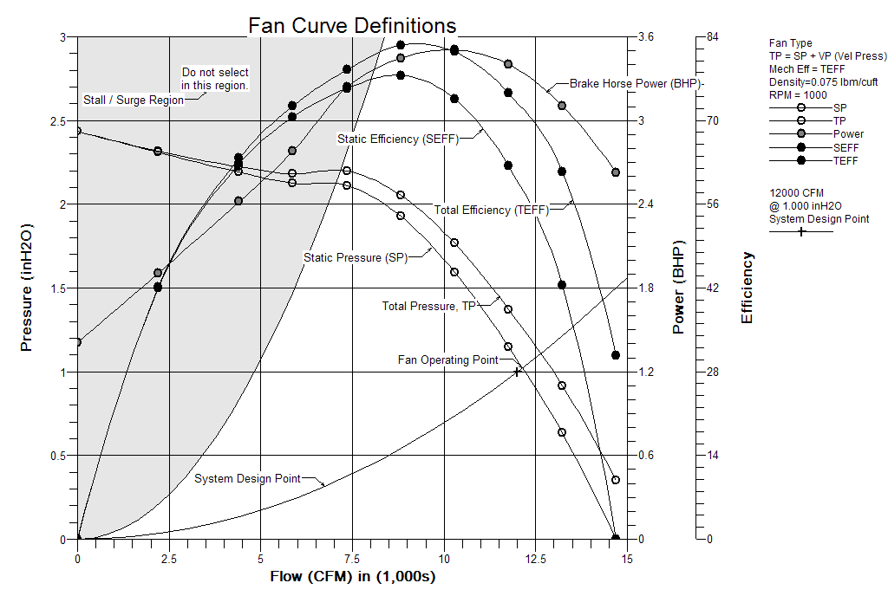
Section 4: Fan Curves
Notes:
Ok – These are the last few tidbits about reading fan curves.
There are a few things I want to highlight here:
You’ll notice a grayed out area on the left. This is the do not select a fan over here region. Coming up shortly I am going to explain why.
Next I’d like introduce the Total Pressure Curve and the Total Efficiency Curve. This is less important for selection, but good to know. These curves include velocity pressure as well as the static pressure. The key piece to remember here is that there can be significant difference between total efficiency and static efficiency – make sure you are comparing apples to apples.

Slide 51


Section 4: Fans in Parallel
SP2 = SP1
CFM2 = 2 CFM1
BHP2 = 2 BHP1
Notes:
Now we will quick talk about how fans in parallel effect a fan curve.
This is most commonly seen in air handling units with plenum fans as shown in the picture on the right.
You’ll see in this curve that the airflow multiplies by the number of fans in parallel, but the static pressure capability remains the same. In this system two fans are being used so the airflow has doubled.

Slide 52


Section 4: Fans in Series
SP2 = 2 SP1
CFM2 = CFM1
BHP2 = 2 BHP1
Notes:
Next we’ll look at fans in series.
This is less common, but fans in system can be used to boost a system when higher static pressure is required.
AS you can see in the curves – the airflow remains constant, but the static pressure capabilities increase by the multiple of fans in system. In this case it is two fans so the static pressure capability increases by a factor of 2.

Slide 53


Section 4: Surge
Interaction with system
Fan operation is very unstable
Pulsating flow at inlet and discharge
Notes:
Alright, now let’s talk about surge. No - Not the 90’s Mountain Dew soda Knock off.
This is what I was referring to earlier on in this section. This can occur when a fan is operating too high on or on the left side of the fan performance curve. The fan could be hunting between these several points trying to find its operating point.
This will impede the fans ability to perform and can have catastrophic effects to the structural integrity of a fan.

Slide 54

Section 4: Surge
Notes:
This video depicts a fan operating under normal conditions. You can hear the consistent hum of the fan.

Slide 55

Section 4: Surge
Notes:
This video depicts the same fan in surge. You can see the fan appearing to breathe as it pushes and pulls air back and forth. You can also clearly hear the sound of the fan change as it goes through these cycles.

Slide 56

Section 4: Stall
Aerodynamic effect
Fan unstable operation
Less severe than surge
Notes:
Next we’ll talk about stall. This is often seen when a fan is operating to high on the performance curve. This will cause unstable operation and odds are the fan won’t perform as required.
This is less severe than surge, but is still not a good application.

Slide 57

Section 4: Stall
Notes:
This video shows the beginnings of such an effect. This is called natural flow separation. A stalled fan would have strings going in all different directions.
A potential fix to this problem could be done by adding twisted vanes to the fan to help direct the flow of air better through the fan.

Slide 58

Section 4: Stall
Notes:
I have slowed the video down here for better visualization.

Slide 59
Section 5: The Affinity Laws ( Fan Laws )
5
Dynamic Similitude
Law 1: RPM Change
Law 2: Diameter Change
Law 3: Diameter & RPM Change
Law 4: Density Effects
Notes:
Ok – On to our last section – the Affinity laws or what is often referred to as the fan laws.
First we will cover the definition of dynamic similitude.
The we will go over each of the 4 laws. I have highlighted and underlined laws 1 and 4 because they are the most practical in todays times.

Slide 60


Section 5: Dynamic Similitude
Definition: The compared systems are geometrically similar and the forces acting in each system act in the same ratio to the forces of the other system.
Scaled Dimensions
Scaled Forces
The Affinity Laws or only applicable in dynamically similar systems.
Notes:
The requirement for two systems to be dynamically similar is that The compared systems are geometrically similar and the forces acting in each system act in the same ratio to the forces of the other system.
In the HVAC world Something that could throw this off would be a control damper
An example of this would be like building a smaller prototype for a car or airplane. The model would need to be to scale and the forces applied to to the scale model and the actual size model would need to be done at the ratio of that scale.

Slide 61

Section 5: Law #1 – RPM Change
10000 CFM at 4” Static Pressure | RPM = 1500 RPM | 4.5 BHP
We Need 12000 CFM
$$\frac{10000 CFM}{12000 CFM}= \frac{1500 RPM}{X}$$
$$\frac{10000 CFM}{12000 CFM}= \frac{1500 RPM}{1800 RPM}$$
20%
$$\frac{4"}{5.76"}= {\left(\frac{1500 RPM}{1800 RPM}\right)}^{2}$$
$$\frac{4"}{X}= {\left(\frac{1500 RPM}{1800 RPM}\right)}^{2}$$
44%
$$\frac{4.5 BHP}{7.76 BHP}= {\left(\frac{1500 RPM}{1800 RPM}\right)}^{3}$$
$$\frac{4.5 BHP}{X}= {\left(\frac{1500 RPM}{1800 RPM}\right)}^{3}$$
72%
Notes:
Law #1 explains how changing the rpm of a fan changes the flow, pressure, and brake horse power.
You can see here that the flow changes at a 1:1 ratio of the rpm,
The static pressure changes at the ratio of a square
And the brake horsepower changes at the ratio of a cube.
This is especially important today because how easy it is to change the speed of a fan using a VFD, EC motor, or speed controller.
To better illustrate what happens I will walk through an example. Often times there are situations where we need just a little more air or a customer is hoping they can still use there current fan, but expand there system.
In this situation we need increase our airflow from 10,000 cfm to 12,000 cfm.
…
CLICK FOR POST IT –
Don’t burn out your motor!

Slide 62


Section 5: Law #2 – Diameter Change
$$\frac{3646 CFM}{X}= {\left(\frac{10.5}{12.2}\right)}^{3}$$
$$\frac{3646 CFM}{5789 CFM}= {\left(\frac{10.5}{12.2}\right)}^{3}$$
$$\frac{3.08"}{X}= {\left(\frac{10.5}{12.2}\right)}^{2}$$
$$\frac{3.08"}{4.19"}= {\left(\frac{10.5}{12.2}\right)}^{2}$$
$$\frac{3.41 BHP}{X}= {\left(\frac{10.5}{12.2}\right)}^{5}$$
$$\frac{3.41 BHP}{7.37 BHP}= {\left(\frac{10.5}{12.2}\right)}^{5}$$
Rarely Applicable
Notes:
Law two focus’s on the effect of changing your diameter. Since the inception of selector programs this law’s use has greatly decreased in the industry because the programs can do it for you.
AS an example Let’s figure out how a diameter change would change our performance…
So here we’re going from a 10.5” wheel to a 12.2” wheel

Slide 63


Section 5: Law #3 – RPM & Diameter Change
Rarely Applicable
Notes:
Law 3 is the combination of laws 1 and 2. you can see this in the graph on the right. I will move through this since we’ve already explained these laws on the previous slides.

Slide 64

Section 5: Law #4 – Density Effects
Fan volume will not change as density changes:
$${CFM}_{1}= {CFM}_{2}$$
SPP and BHP will vary in direct proportion to density change:
$$\frac{ρ_{1}}{ρ_{2}}= \frac{{SP}_{1}}{{SP}_{2}}= \frac{{BHP}_{1}}{{BHP}_{2}}$$
$$\frac{.075 {lb/ft}^{3} }{.060 {lb/ft}^{3} }= \frac{3.08"}{2.46"}= \frac{3.41 BHP}{2.73 BHP}$$
Notes:
The final law is a big one. I told you earlier to remember how important your density is. This law shows you how your static pressure and brake horse power change with air density.
I have worked out the equation to show you the difference in the approximate air density in Denver vs. the approximate air density in New Orleans.
The Big takeaway is that If I were to install this fan in Denver with a 3 HP motor it would function fine, but If I threw it in the back of my truck and drove to New Orleans and fired it up the motor would burn out because of the change in density.

Slide 65
In Conclusion: 3 Take-aways
Every system and every fan is different. Now we can better design, plan for, measure, and troubleshoot these systems.
Perceived small changes can cause big unintended effects.
You don’t need to memorize the fundamentals to be successful in the HVAC industry, but the more you know, the more valuable you can be to your customers.
Notes:
So in conclusion…
Every system and every fan is different. Now we can better design, plan for, measure, and troubleshoot these systems.
Perceived small changes can cause big unintended effects.
You don’t need to memorize the fundamentals to be successful in the HVAC industry, but the more you know, the more valuable you can be to your customers.

Slide 66
Resources
AMCA International: www.amca.org
AMCA Presentations: www.amca.org/educate/#videos
> ASET-US 2018 – “Fan Sizing and Selection: Basics and Fine Points” by Mike Wolf
> ASET-US 2018 – “Tips and Tricks for Troubleshooting Fans” by Ron Wroblewski
AMCA Publications: www.amca.org/store (available for purchase)
> 201-02 (R2011) – Fans and Systems

Slide 67
Thank you for your time!
To receive PDH credit for today’s program, you must complete the online evaluation, which will be sent via email 1 hour after the conclusion of this session.
PDH credits and participation certificates will be issued electronically within 30 days, once all attendance records are checked and online evaluations are received.
Attendees will receive an email at the address provided on your registration, listing the credit hours awarded and a link to a printable certificate of completion.
Notes:
Lisa presents this slide.
Thank you for your time today.
PDH credit requires completing survey link that follows.

Slide 68
Questions?
Notes:
Question and Answer session

Slide 69

NEXT PROGRAM
Join us for our next AMCA & O’Dell Associates Education Session:
- Thursday, October 28
- 10:00-11:00am ET
Topic: Introduction to Fan Energy Index (FEI)
Presenter: Mark Bublitz, Executive Vice President- Engineering, The New York Blower Company
>> For additional session details please contact Sarah Johnson, Marketing Manager, O’Dell Associates (sjohnson@odellassoc.com)
Notes:
Lisa to present this slide.

