Slide 1
Fan Laws: An Introduction to Their Application
AMCA & O’Dell Associates Education Series | Session 1| September 16, 2021

Slide 2

Lisa Cherney
Education Manager, AMCA International
Webinar Moderator
• Joined AMCA in February 2019
• Responsible for development of AMCA’s education programs; staff liaison for the Education & Training Committee
• Projects include webinars, AMCA’s online learning platform programming, presentations at trade shows, PDH/RCEP account management, and AMCA’s Speakers Network

Slide 3
Introductions & Guidelines
Participation Guidelines:
  Audience will be muted during the session.
  Questions can be submitted anytime via the Airmeet platform and will be addressed at the end of the presentation.
  Reminder: This session is being recorded!
  To earn PDH credit for today, please stay clicked onto the platform for the entire hour.
  A post-program survey will be emailed to everyone within one hour of the conclusion. Your feedback is greatly appreciated, and the survey must be completed to qualify for today’s PDH credit.

Slide 4
Q & A
To submit questions:
From the interactive panel on the right side of the screen, select the “Q&A” option at the top.
Type your question in the box and click “Send”.
Remember: All attendees can see all questions submitted.
Questions will be answered at the end of the program.

Slide 5

AMCA International has met the standards and requirements of the Registered Continuing Education Program. Credit earned on completion of this program will be reported to RCEP at RCEP.net. A certificate of completion will be issued to each participant. As such, it does not include content that may be deemed or construed to be an approval or endorsement by the RCEP.
Attendance for the entire presentation AND a completed evaluation are required for PDH credit to be issued.

Slide 6
DISCLAIMER
The information contained in this webinar is provided by AMCA International as an educational service and is not intended to serve as professional engineering and/or manufacturing advice. The views and/or opinions expressed in this educational activity are those of the speaker(s) and do not necessarily represent the views of AMCA International. In making this educational activity available to its members and others, AMCA International is not endorsing, sponsoring or recommending a particular company, product or application. Under no circumstances, including negligence, shall AMCA International be liable for any damages arising out of a party’s reliance upon or use of the content contained in this webinar.

Slide 7
COPYRIGHT MATERIALS
This educational activity is protected by U.S. and International copyright laws. Reproduction, distribution, display and use of the educational activity without written permission of the presenter is prohibited.
© AMCA International 2021

Slide 8

William Howarth
AMCA Consultant; President- Ventilation & Fan Consulting Service International
Independent Consultant since 2017
30-yrs Fan Engineering & Sales at Illinois Blower and Hartzell Fan
Instructor at North Carolina Industrial Ventilation Conference
Member US delegation for ISO Technical Committee 117 Fans
Active ASHRAE Member
Notes:
Please send moderator any questions you have during the presentation.
At the end of the webinar we will have a question and answer session.
Introduction… Insert fan humor here…
After his death, the lawyer found himself with the devil in a room filled with clocks. Each clock turned at a different speed and was labeled with the name of a different occupation.
After examining all the clocks, the lawyer turned to the devil and said, "I have two questions. First, why does each clock move at a different speed?"
"They turn at the rate at which the members of that occupation collectively sin on earth," replied the devil.
"What's your second question?"
"Well," said the lawyer. "I can't seem to find my occupation. Where is the 'lawyers' clock?"
The devil momentarily looked confused, and he started checking the clocks. "They should all be here," he muttered, looking frantically, "It has to be here somewhere... Oh, there will be Hell to pay for this.“
Suddenly, the devil relaxed, slapped himself on the forehead, and exclaimed, "Oh, yes! How silly of me. We keep that clock in the workshop and use it for a fan. - Lawyers Clock

Slide 9
Fan Laws: An Introduction to Their Application
Purpose and Learning Objectives
The purpose of this presentation is to educate manufacturer’s representatives, engineers, system designers, and fan specialists on the fan laws and their application.
At the end of this presentation, you will be able to:
Define fan performance rating.
Explain how fans are tested and associated variables.
Identify the fan curve.
Outline the fan laws.
Describe how the fan laws are used in development of fan ratings.

Slide 10
Fan Law Topics
Fan Ratings and Fan Testing
Variables in fan testing
Introduction of the fan laws
Development of fan curve
Application of the fan laws for developing fan ratings

Slide 11

Fan Ratings
FAN – A device that uses a power-driven rotating impeller to move air or gas
Fan Aerodynamic Performance Ratings
  Airflow
  Pressure (total or static)
  Power
  Speed
AMCA currently has over 300 companies with certified ratings for “Air Performance”
  Thousands of catalogs and air performance ratings
  AMCA confirms calculations for products that comply with its Certified Ratings Program (CRP)
The Fan Laws are used to calculate fan performance ratings

Slide 12
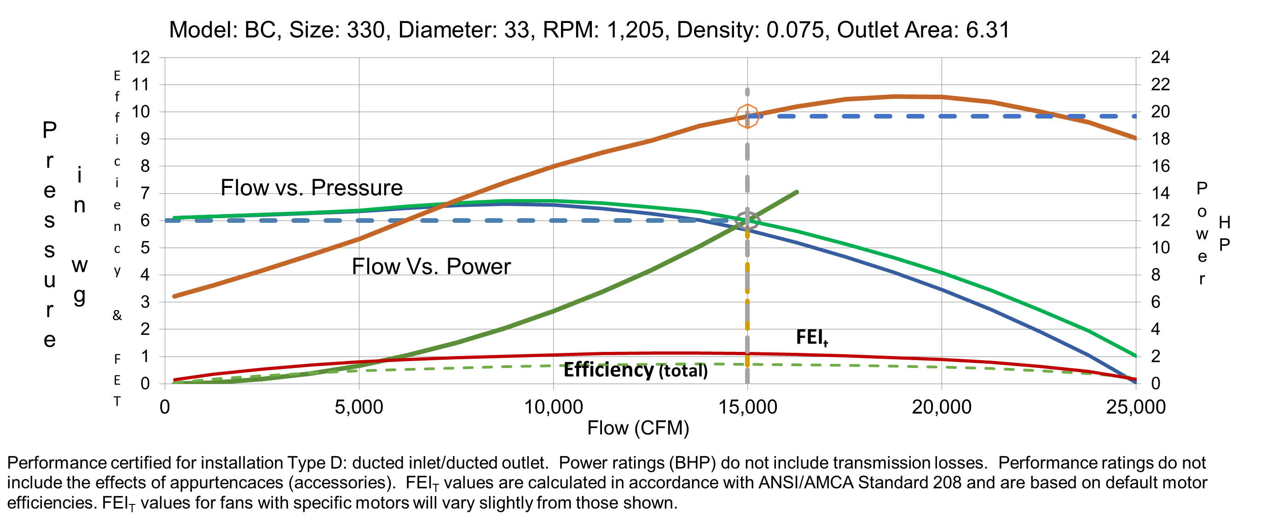
The Fan Performance Rating and Curve
Fan Performance Rating is the pressure rise (total or static) and the volume airflow rate generated by a fan, and its power consumption at any given point of operation. Each point on this curve is a rating point.
Notes:
Fan curves include a lot of information and can be confusing!
Fan Performance Rating is the pressure rise (total or static) and the volume airflow rate generated by a fan, and its power consumption at any given point of operation.
Each point on this curve is a rating point.
Every fan type and size has a unique fan performance curve.
There is a lot of information on the curve. Here is a fan curve with a lot of information.
Flow versus total pressure
Flow versus static pressure
Flow versus power
System flow versus pressure
Flow versus efficiency (static? or total?)
Fan Energy Index versus flow
Additional data on curve: Model, Size, Diameter, RPM, Density, Notes, AMCA Certification, Drive Losses, Apprutences
Select a fan which will generate the required pressure at the desired airflow.
Model, size, speed, density, outlet area,
How the fan was tested
What losses are included
How Fan Energy Index was calculated

Slide 13
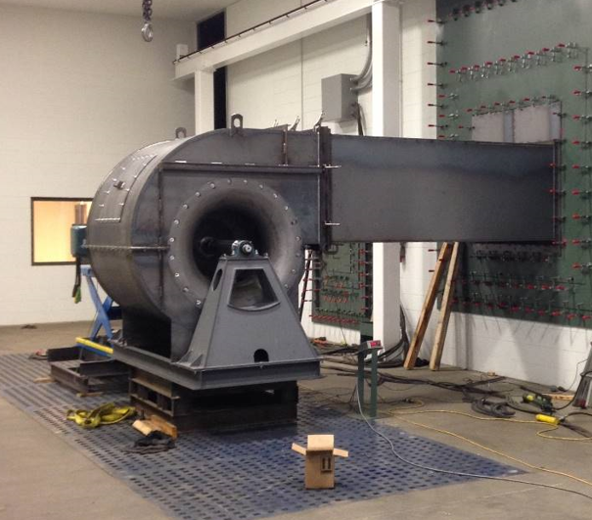
Fan Testing
Aerodynamic performance is determined by a test.
The air performance rating of a fan or a series of similar fans are developed from tests conducted in accordance with ANSI/AMCA 210, ISO 5801, or other testing standards recognized in AMCA 111, using the same standardized airways.
Source: AMCA Laboratory

Slide 14
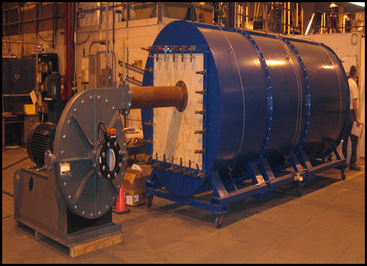
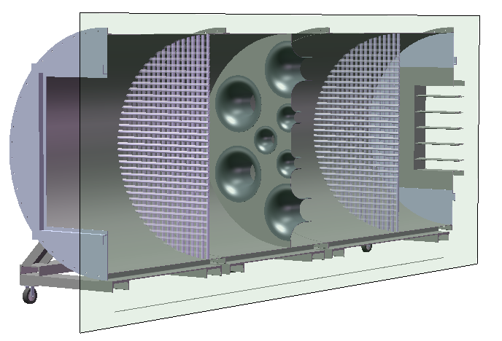
Fan Performance Test Standards
The Aerodynamic Performance Test
  AMCA Standard 210 - "Laboratory Methods of Testing Fans for Certified Aerodynamic Performance Rating“

Slide 15
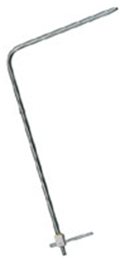
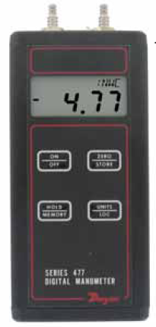
Fan Performance Test Instruments
Test Equipment
  Measure Flow (indirectly)
    Pitot tube traverse
    Flow Nozzle
    Flow Measurement Station
  Measure Fan Pressure
    Inlet Pressure
    Outlet Pressure
  Measure Fan Power
  Measure Fan Speed
  Measure Air Parameters
    Dry Bulb Temp.
    Wet Bulb Temp.
    Barometric Pressure
    System Air Temp

Slide 16
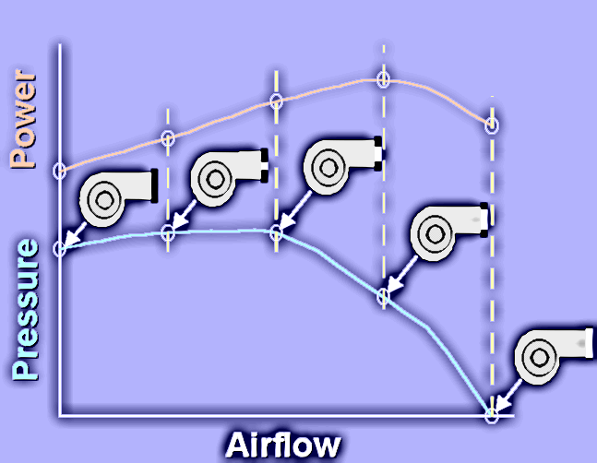
Fan Performance Test
Accurate prediction of aerodynamic performance requires a test.
  Measure Flow (indirectly)
  Measure Fan Pressure
  Measure Fan Power
  Measure Fan Speed
  Measure Air Parameters
Performance test develops fan curve

Slide 17
Aerodynamic Performance Test Data
Test Data collected and calculated per test standard
  Air density is calculated based on air parameters.
  Speed is measured directly.
  Pressure(s) is measured directly and corrected per standard.
  Flow is calculated based on differential pressure across flow nozzles.
  Power is measured directly and corrected per standard.
The results are at different air densities and speeds.
The Fan Laws are used to normalize data.
Det. No. | ρ | N | Ps | Q | Hi
 | (lbm/ft³) | (rpm) | (in. wg) | (cfm) | (hp)
1 | 0.0724 | 1501 | 0.001 | 28889 | 33.565
2 | 0.0724 | 1500 | 3.732 | 25958 | 39.000
3 | 0.0723 | 1499 | 6.955 | 22702 | 41.592
4 | 0.0723 | 1499 | 10.154 | 19654 | 42.908
5 | 0.0724 | 1499 | 12.300 | 16821 | 41.619
6 | 0.0724 | 1500 | 14.150 | 13331 | 38.026
7 | 0.0724 | 1502 | 13.900 | 9952 | 31.002
8 | 0.0724 | 1505 | 14.500 | 6695 | 22.745
9 | 0.0724 | 1506 | 15.000 | 3764 | 20.162
10 | 0.0726 | 1501 | 12.500 | 0 | 14.761
The variables associated with fan performance are:
  Flow
  Pressure
  Power
  Speed
  Density
  Size (diameter)

Slide 18
Standard Air Uses and Changes
Standard Air → standard density
  Reference gas for:
    Fan Catalogs
    Performance test results
    Rating tables
    Data sets
  STP - Standard Temperature and Pressure
Standard air in nature is rare
Fans handle actual air or gas
Change the recipe → change the density → Change the Factor
  Temperature
  Pressure
  Ingredient gas mix
Temperature Factor
Pressure Factor
Gas (MW) Factor
Notes:
Standard Air → standard density
Reference gas for:
Fan Catalogs
Performance test results
Rating tables
Data sets
STP - Standard Temperature and Pressure
Standard air in nature is rare
Fans handle actual air or gas
Change the recipe → change the density → Change the Factor
Temperature
Pressure
Ingredient gas mix

Slide 19
The Fan Laws
  The Fan Laws are used to calculate fan performance at:
  Other Speeds
  Other Densities
  Other Sizes
    Impellers and casings have same geometric design but differ only in size
  Fan Laws are like pump affinity laws
  Fan Laws apply where Fan Reynolds Numbers are similar
    Speed
    Density
    Sizes

Slide 20
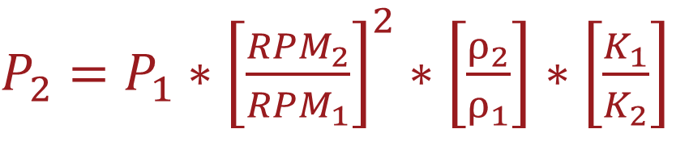
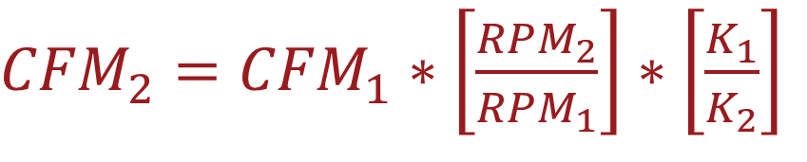
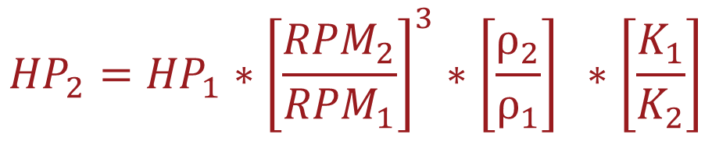
Basic Fan Laws
Normalize data to standard conditions:
  Average RPM
  Standard Air Density of 0.075 lbm/ft³
Flow is proportional to speed
Pressure is proportional to:
  The speed ratio squared
  The density ratio
Power is proportional to:
  The speed ratio cubed
  The density ratio
K₁/K₂ - Gas compressibility affects the results.
  For this introduction K₁/K₂ will be considered to be K₁/K₂ =1
${CFM}_{2}={CFM}_{1}∗\left[\frac{{RPM}_{2}}{{RPM}_{1}}\right]$ $∗\left[\frac{K_{1}}{K_{2}}\right]$
$P_{2}=P_{1}∗{\left[\frac{{RPM}_{2}}{{RPM}_{1}}\right]}^{2}∗\left[\frac{ρ_{2}}{ρ_{1}}\right]$ $∗\left[\frac{K_{1}}{K_{2}}\right]$
$${HP}_{2}={HP}_{1}∗{\left[\frac{{RPM}_{2}}{{RPM}_{1}}\right]}^{3}∗\left[\frac{ρ_{2}}{ρ_{1}}\right] ∗\left[\frac{K_{1}}{K_{2}}\right]$$

Slide 21
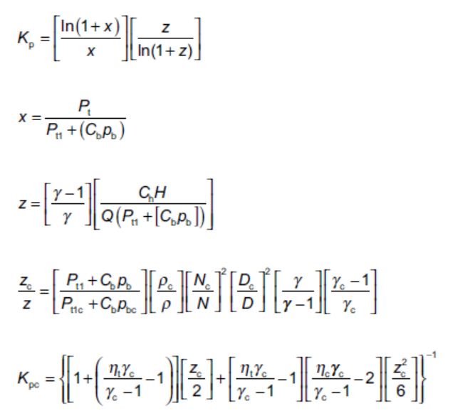
Gas Compressibility Coefficient K_{p} /K_{pc}
Air is a compressible fluid.
  Volume changes with pressure, temperature and power.
  Pressure changes with volume, temperature and power.
  Power changes with pressure, volume, and temperature.
As volume, pressure, and power change the process is iterative.
Compressibility calculation is beyond the scope of this session and is only shown here.
  For this introduction K₁/K₂ will be considered to be K₁/K₂ =1

Slide 22

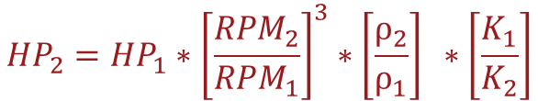
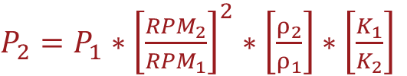


Fan Laws Applied To Pressure Point
Flow vs Pressure Point Adjustment
${CFM}_{2}={CFM}_{1}∗\left[\frac{{RPM}_{2}}{{RPM}_{1}}\right]$ $∗\left[\frac{K_{1}}{K_{2}}\right]$
$P_{2}=P_{1}∗{\left[\frac{{RPM}_{2}}{{RPM}_{1}}\right]}^{2}∗\left[\frac{ρ_{2}}{ρ_{1}}\right]$ $∗\left[\frac{K_{1}}{K_{2}}\right]$
 | ρ | N | Q | Ps | Hi
Raw Data | 0.0724 | 1499 | 16821 | 12.300 | 41.619
Std. Data | 0.0750 | 1500 | 16839 | 12.755 | 43.188
${CFM}_{2}={CFM}_{1}∗\left[\frac{{RPM}_{2}}{{RPM}_{1}}\right]$ $∗\left[\frac{K_{1}}{K_{2}}\right]$
$P_{2}=P_{1}∗{\left[\frac{{RPM}_{2}}{{RPM}_{1}}\right]}^{2}∗\left[\frac{ρ_{2}}{ρ_{1}}\right]$ $∗\left[\frac{K_{1}}{K_{2}}\right]$
$${HP}_{2}={HP}_{1}∗{\left[\frac{{RPM}_{2}}{{RPM}_{1}}\right]}^{3}∗\left[\frac{ρ_{2}}{ρ_{1}}\right] ∗\left[\frac{K_{1}}{K_{2}}\right]$$

Slide 23

Fan Laws Applied To Power Point
Flow vs Power Point Adjustment
${CFM}_{2}={CFM}_{1}∗\left[\frac{{RPM}_{2}}{{RPM}_{1}}\right]$ $∗\left[\frac{K_{1}}{K_{2}}\right]$
$${HP}_{2}={HP}_{1}∗{\left[\frac{{RPM}_{2}}{{RPM}_{1}}\right]}^{3}∗\left[\frac{ρ_{2}}{ρ_{1}}\right] ∗\left[\frac{K_{1}}{K_{2}}\right]$$
 | ρ | N | Q | Ps | Hi
Raw Data | 0.0724 | 1499 | 16821 | 12.300 | 41.619
Std. Data | 0.0750 | 1500 | 16839 | 12.755 | 43.188
${CFM}_{2}={CFM}_{1}∗\left[\frac{{RPM}_{2}}{{RPM}_{1}}\right]$ $∗\left[\frac{K_{1}}{K_{2}}\right]$
$P_{2}=P_{1}∗{\left[\frac{{RPM}_{2}}{{RPM}_{1}}\right]}^{2}∗\left[\frac{ρ_{2}}{ρ_{1}}\right]$ $∗\left[\frac{K_{1}}{K_{2}}\right]$
$${HP}_{2}={HP}_{1}∗{\left[\frac{{RPM}_{2}}{{RPM}_{1}}\right]}^{3}∗\left[\frac{ρ_{2}}{ρ_{1}}\right] ∗\left[\frac{K_{1}}{K_{2}}\right]$$

Slide 24
Normalize Points To Speed & Standard Density
Raw Data
ρ | N | Q | Ps | Hi
(lbm/ft³) | (rpm) | (cfm) | (in. wg) | (hp)
0.0724 | 1501 | 28889 | 0.001 | 33.565
0.0724 | 1500 | 25958 | 3.732 | 39.000
0.0723 | 1499 | 22702 | 6.955 | 41.592
0.0723 | 1499 | 19654 | 10.154 | 42.908
0.0724 | 1499 | 16821 | 12.300 | 41.619
0.0724 | 1500 | 13331 | 14.150 | 38.026
0.0724 | 1502 | 9952 | 13.900 | 31.002
0.0724 | 1505 | 6695 | 14.500 | 22.745
0.0724 | 1506 | 3764 | 15.000 | 20.162
0.0726 | 1501 | 0 | 12.500 | 14.761
Standardized Data
ρ | N | Q | Ps | Hi
(lbm/ft³) | (rpm) | (cfm) | (in. wg) | (hp)
0.0750 | 1500 | 28870 | 0.001 | 34.681
0.0750 | 1500 | 25961 | 3.866 | 40.399
0.0750 | 1500 | 22723 | 7.222 | 43.214
0.0750 | 1500 | 19674 | 10.545 | 44.587
0.0750 | 1500 | 16839 | 12.755 | 43.188
0.0750 | 1500 | 13336 | 14.655 | 39.382
0.0750 | 1500 | 9942 | 14.359 | 31.983
0.0750 | 1500 | 6674 | 14.916 | 23.319
0.0750 | 1500 | 3750 | 15.408 | 20.627
${CFM}_{2}={CFM}_{1}∗\left[\frac{{RPM}_{2}}{{RPM}_{1}}\right]$ $∗\left[\frac{K_{1}}{K_{2}}\right]$
$P_{2}=P_{1}∗{\left[\frac{{RPM}_{2}}{{RPM}_{1}}\right]}^{2}∗\left[\frac{ρ_{2}}{ρ_{1}}\right]$ $∗\left[\frac{K_{1}}{K_{2}}\right]$
$${HP}_{2}={HP}_{1}∗{\left[\frac{{RPM}_{2}}{{RPM}_{1}}\right]}^{3}∗\left[\frac{ρ_{2}}{ρ_{1}}\right] ∗\left[\frac{K_{1}}{K_{2}}\right]$$

Slide 25
Fan Curve At Conditions
The data points are curve fit together to generate a fan curve.
Fan Laws used to generate Performance Curve at:
  Fan Diameter 36.5 inches
  Fan RPM: 1500
  Air Density: 0.075 lbm/ft³
${CFM}_{2}={CFM}_{1}∗\left[\frac{{RPM}_{2}}{{RPM}_{1}}\right]$ $∗\left[\frac{K_{1}}{K_{2}}\right]$
$P_{2}=P_{1}∗{\left[\frac{{RPM}_{2}}{{RPM}_{1}}\right]}^{2}∗\left[\frac{ρ_{2}}{ρ_{1}}\right]$ $∗\left[\frac{K_{1}}{K_{2}}\right]$
$${HP}_{2}={HP}_{1}∗{\left[\frac{{RPM}_{2}}{{RPM}_{1}}\right]}^{3}∗\left[\frac{ρ_{2}}{ρ_{1}}\right] ∗\left[\frac{K_{1}}{K_{2}}\right]$$

Slide 26
Fan Curve At Conditions
Fan Laws used to generate Performance Curve at:
  Fan RPM:
    1500 RPM
    1800 RPM
  Air Density:
    0.075 lbm/ft³
    0.075 lbm/ft³
${CFM}_{2}={CFM}_{1}∗\left[\frac{{RPM}_{2}}{{RPM}_{1}}\right]$ $∗\left[\frac{K_{1}}{K_{2}}\right]$
$P_{2}=P_{1}∗{\left[\frac{{RPM}_{2}}{{RPM}_{1}}\right]}^{2}∗\left[\frac{ρ_{2}}{ρ_{1}}\right]$ $∗\left[\frac{K_{1}}{K_{2}}\right]$
$${HP}_{2}={HP}_{1}∗{\left[\frac{{RPM}_{2}}{{RPM}_{1}}\right]}^{3}∗\left[\frac{ρ_{2}}{ρ_{1}}\right] ∗\left[\frac{K_{1}}{K_{2}}\right]$$

Slide 27
Fan Curve At Conditions
Fan Laws used to generate Performance Curve at:
  Fan RPM:
    1500 RPM
    1500 RPM
  Air Density:
    0.075 lbm/ft³
    0.0375 lbm/ft³
${CFM}_{2}={CFM}_{1}∗\left[\frac{{RPM}_{2}}{{RPM}_{1}}\right]$ $∗\left[\frac{K_{1}}{K_{2}}\right]$
$P_{2}=P_{1}∗{\left[\frac{{RPM}_{2}}{{RPM}_{1}}\right]}^{2}∗\left[\frac{ρ_{2}}{ρ_{1}}\right]$ $∗\left[\frac{K_{1}}{K_{2}}\right]$
$${HP}_{2}={HP}_{1}∗{\left[\frac{{RPM}_{2}}{{RPM}_{1}}\right]}^{3}∗\left[\frac{ρ_{2}}{ρ_{1}}\right] ∗\left[\frac{K_{1}}{K_{2}}\right]$$

Slide 28
Fan Curve At Conditions
Fan Laws used to generate Performance Curve at:
  Fan RPM:
    1500 RPM
    1800 RPM
  Air Density:
    0.075 lbm/ft³
    0.0375 lbm/ft³
${CFM}_{2}={CFM}_{1}∗\left[\frac{{RPM}_{2}}{{RPM}_{1}}\right]$ $∗\left[\frac{K_{1}}{K_{2}}\right]$
$P_{2}=P_{1}∗{\left[\frac{{RPM}_{2}}{{RPM}_{1}}\right]}^{2}∗\left[\frac{ρ_{2}}{ρ_{1}}\right]$ $∗\left[\frac{K_{1}}{K_{2}}\right]$
$${HP}_{2}={HP}_{1}∗{\left[\frac{{RPM}_{2}}{{RPM}_{1}}\right]}^{3}∗\left[\frac{ρ_{2}}{ρ_{1}}\right] ∗\left[\frac{K_{1}}{K_{2}}\right]$$

Slide 29
Fan Laws Predict Performance
Fan Laws can be used to predict aerodynamic performance at other sizes.
  Fans are dimensionally similar series.
  Blade style and angle cannot be changed.
  Impellers and casings have same geometric design but differ only in size.
  Increase in size normally and required for AMCA certification.
  Minor changes for construction gauge thickness are allowed.
  Manufacturers make the calculations:
    Printed and pdf catalogs
    Electronic selection programs
  AMCA confirms calculations for AMCA Certified Ratings Program (CRP).

Slide 30
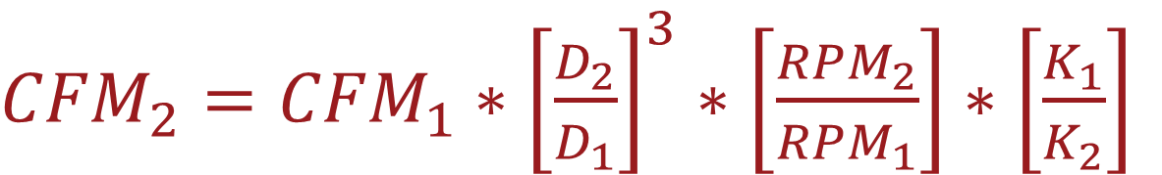
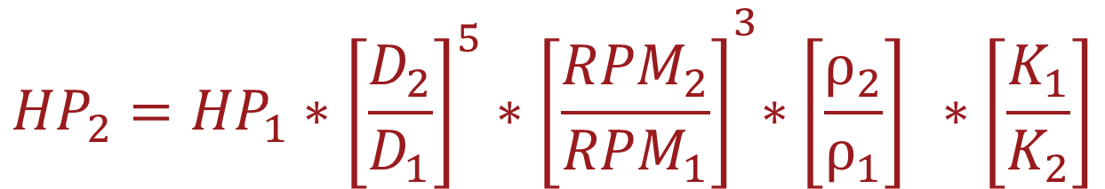
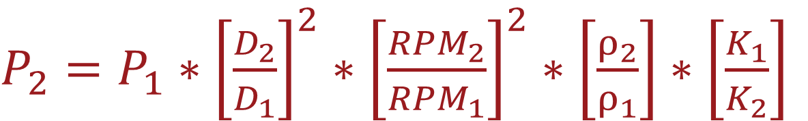
The Fan Laws
  The Fan Laws are used to calculate fan performance at:
  Other Speeds, Densities, and Sizes
${CFM}_{2}={CFM}_{1}∗{\left[\frac{D_{2}}{D_{1}}\right]}^{3}∗\left[\frac{{RPM}_{2}}{{RPM}_{1}}\right]$ $∗\left[\frac{K_{1}}{K_{2}}\right]$
First Law:
$P_{2}=P_{1}∗{\left[\frac{D_{2}}{D_{1}}\right]}^{2}∗{\left[\frac{{RPM}_{2}}{{RPM}_{1}}\right]}^{2}∗\left[\frac{ρ_{2}}{ρ_{1}}\right]$ $∗\left[\frac{K_{1}}{K_{2}}\right]$
Second Law:
$${HP}_{2}={HP}_{1}{∗{\left[\frac{D_{2}}{D_{1}}\right]}^{5}∗\left[\frac{{RPM}_{2}}{{RPM}_{1}}\right]}^{3}∗\left[\frac{ρ_{2}}{ρ_{1}}\right] ∗\left[\frac{K_{1}}{K_{2}}\right]$$
Third Law:

Slide 31
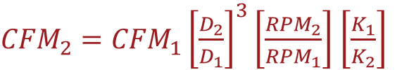
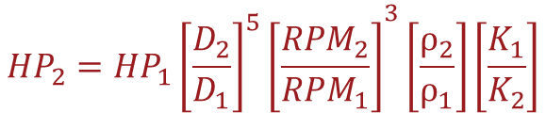
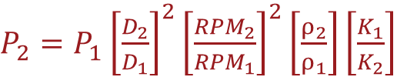
Fan Curve At Conditions
Fan Laws used to generate Performance Curve at:
  Fan Diameter:
    36.5 inches
    40.25 inches
  Fan RPM:
    1500 RPM
    1500 RPM
  Air Density:
    0.075 lbm/ft³
    0.075 lbm/ft³
${CFM}_{2}={CFM}_{1}{\left[\frac{D_{2}}{D_{1}}\right]}^{3}\left[\frac{{RPM}_{2}}{{RPM}_{1}}\right]$ $\left[\frac{K_{1}}{K_{2}}\right]$
$P_{2}=P_{1}{\left[\frac{D_{2}}{D_{1}}\right]}^{2}{\left[\frac{{RPM}_{2}}{{RPM}_{1}}\right]}^{2}\left[\frac{ρ_{2}}{ρ_{1}}\right]\left[\frac{K_{1}}{K_{2}}\right]$
$${HP}_{2}={HP}_{1}{{\left[\frac{D_{2}}{D_{1}}\right]}^{5}\left[\frac{{RPM}_{2}}{{RPM}_{1}}\right]}^{3}\left[\frac{ρ_{2}}{ρ_{1}}\right]\left[\frac{K_{1}}{K_{2}}\right]$$

Slide 32
Fan Curve At Conditions
Fan Laws used to generate Performance Curve at:
  Fan Diameter:
    36.5 inches
    40.25 inches
  Fan RPM:
    1500 RPM
    1800 RPM
  Air Density:
    0.075 lbm/ft³
    0.0375 lbm/ft³
${CFM}_{2}={CFM}_{1}{\left[\frac{D_{2}}{D_{1}}\right]}^{3}\left[\frac{{RPM}_{2}}{{RPM}_{1}}\right]$ $\left[\frac{K_{1}}{K_{2}}\right]$
$P_{2}=P_{1}{\left[\frac{D_{2}}{D_{1}}\right]}^{2}{\left[\frac{{RPM}_{2}}{{RPM}_{1}}\right]}^{2}\left[\frac{ρ_{2}}{ρ_{1}}\right]\left[\frac{K_{1}}{K_{2}}\right]$
$${HP}_{2}={HP}_{1}{{\left[\frac{D_{2}}{D_{1}}\right]}^{5}\left[\frac{{RPM}_{2}}{{RPM}_{1}}\right]}^{3}\left[\frac{ρ_{2}}{ρ_{1}}\right]\left[\frac{K_{1}}{K_{2}}\right]$$

Slide 33
Fan Law Conclusion
Fan performance ratings are developed by:
  Testing a fan in a laboratory using a test standard
    Fan variables of flow, pressure, speed, and power are measured.
  The Fan Laws are used to normalized test data to standard conditions.
The Fan Laws are used to calculate new fan ratings at:
  New speeds
  New air densities
  New sizes
AMCA Certified Ratings Program (CRP) confirms:
  Accurate performance test results.
  Fan Law Calculation of fan performance ratings.

Slide 34
Resources
AMCA International: www.amca.org
ANSI/AMCA Standards: www.amca.org/store (available for purchase)
> 99-16: Standards Handbook
> 210-16: Laboratory Methods of Testing Fans for Certified Aerodynamic Performance Rating (ASHRAE 51-16)
AMCA Publications: www.amca.org/store (available for purchase)
> 201-02 (R2011) – Fans and Systems
AMCA Certification: www.amca.org/certify
AMCA Education Program: www.amca.org/educate
Notes:
Fan Laws are calculated in detail in 99-16: Standards Handbook
Fan Performance testing standard is 210-16: Laboratory Methods of Testing Fans for Certified Aerodynamic Performance Rating (ASHRAE 51-16)
AMCA Publication 201-02 (R2011) Fans and Systems contains additional information on density effects on fan and system performance.
There will be a question and answer session directly.

Slide 35
Thank you for your time!
To receive PDH credit for today’s program, you must complete the online evaluation, which will be sent via email 1 hour after the conclusion of this session.
PDH credits and participation certificates will be issued electronically within 30 days, once all attendance records are checked and online evaluations are received.
Attendees will receive an email at the address provided on your registration, listing the credit hours awarded and a link to a printable certificate of completion.
Notes:
Lisa presents this slide.
Thank you for your time today.
PDH credit requires completing survey link that follows.

Slide 36
Questions?
Notes:
Question and Answer session

Slide 37

NEXT PROGRAM
Join us for our next AMCA & O’Dell Associates Education Session:
- Thursday, September 30
- 10:00-11:00am ET
Topic: Fan Law Calculations
Presenter: Bill Howarth
>> For additional session details please contact Sarah Johnson, Marketing Manager, O’Dell Associates (sjohnson@odellassoc.com)
Notes:
Lisa to present this slide.

